Slide 1
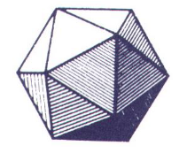
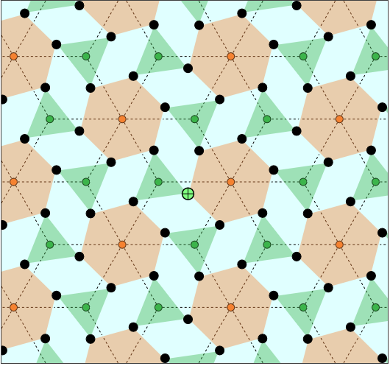
Kaleidoscopic Constructions by Rotational Generators MAA NCS - Spring 2026 talk, March 28, 2026 Tom Ruen, Email: tomruen@gmail.com, Web: http://roice3.org/ruen/
Abstract
Kaleidoscopic constructions of uniform polytopes and tilings with Coxeter groups rely on reflections. We generalize mirrors to discrete rotations to build geometric configurations.
We start with rank-2 signatures _{<k>}(g)_{d} being a k-uniform, d-regular symmetric hypergraph, where g = vd = ke is vertex/edge incidence handshake. The kaleidoscopic seed also yields dual _{k}(g)_{<d>} (activating d-rotation), and free truncations _{<k>}(g)_{<d>} (both active). The dual of truncation defines bipartite Levi graph.
Principles are illustrated in online interactive javascript, highlighting ordinary dihedral mirror symmetry of isogonal polygons (and isotoxal duals), complex apeirogonal tilings, and rotational generator _{p}(g)_{q} within 3D chiral polyhedral symmetries [p,q]+, order g.

Slide 2
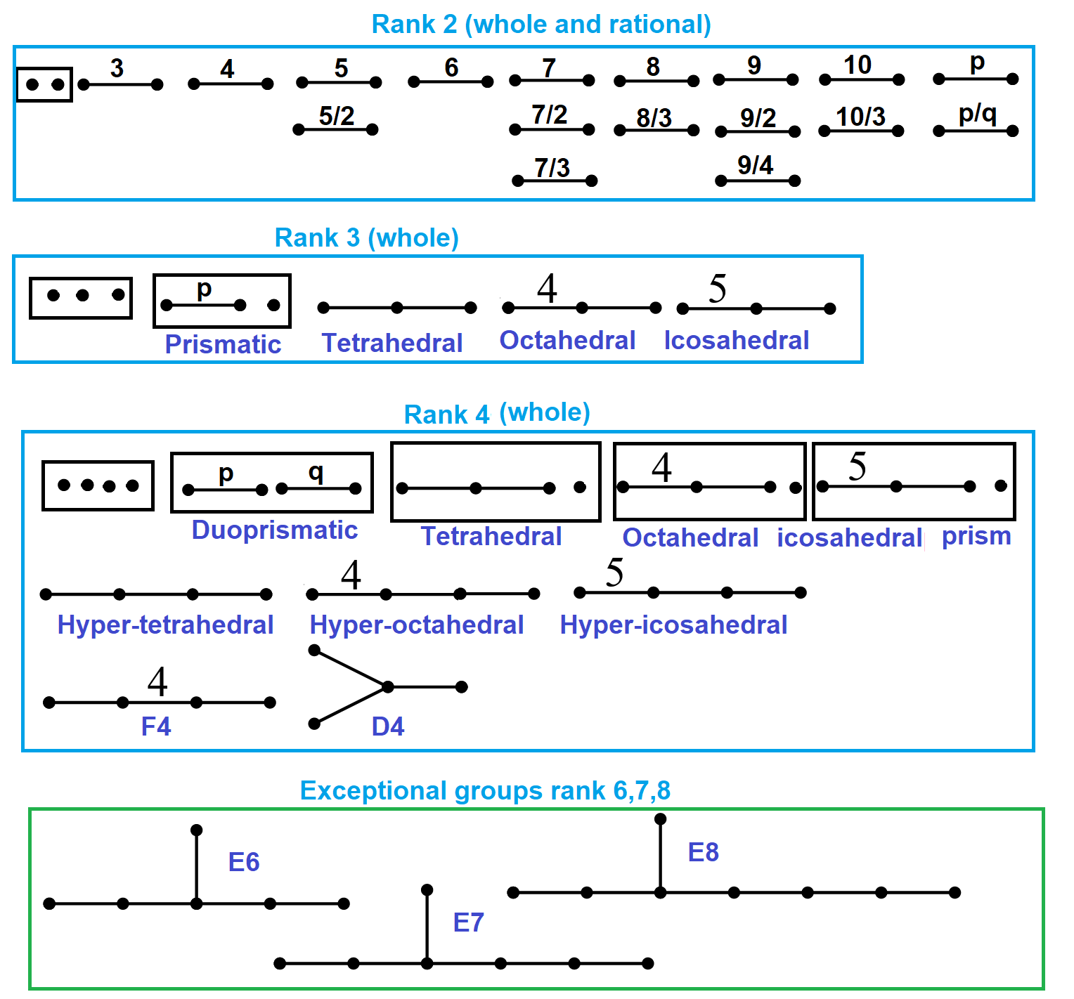
Reflectional Kaleidoscopes
Regular and uniform polytopes can be constructed within families based on ringed permutations on Coxeter diagrams, a seen as a collection of nodes and branches.
Nodes representing n mirror hyperplanes (facets) of an (n-1)-simplex, and branch order p represents the dihedral angle, 180º/p, between the hyperplanes (ridges).
Order 2 (orthogonal) branches are suppressed.
Order 3 branches are unlabeled.
Rational orders are allowed p/q
Disconnected graphs produce “prisms”
Coxeter groups can be finite, Euclidean or hyperbolic.
Finite Coxeter groups are shown (right)

Slide 3
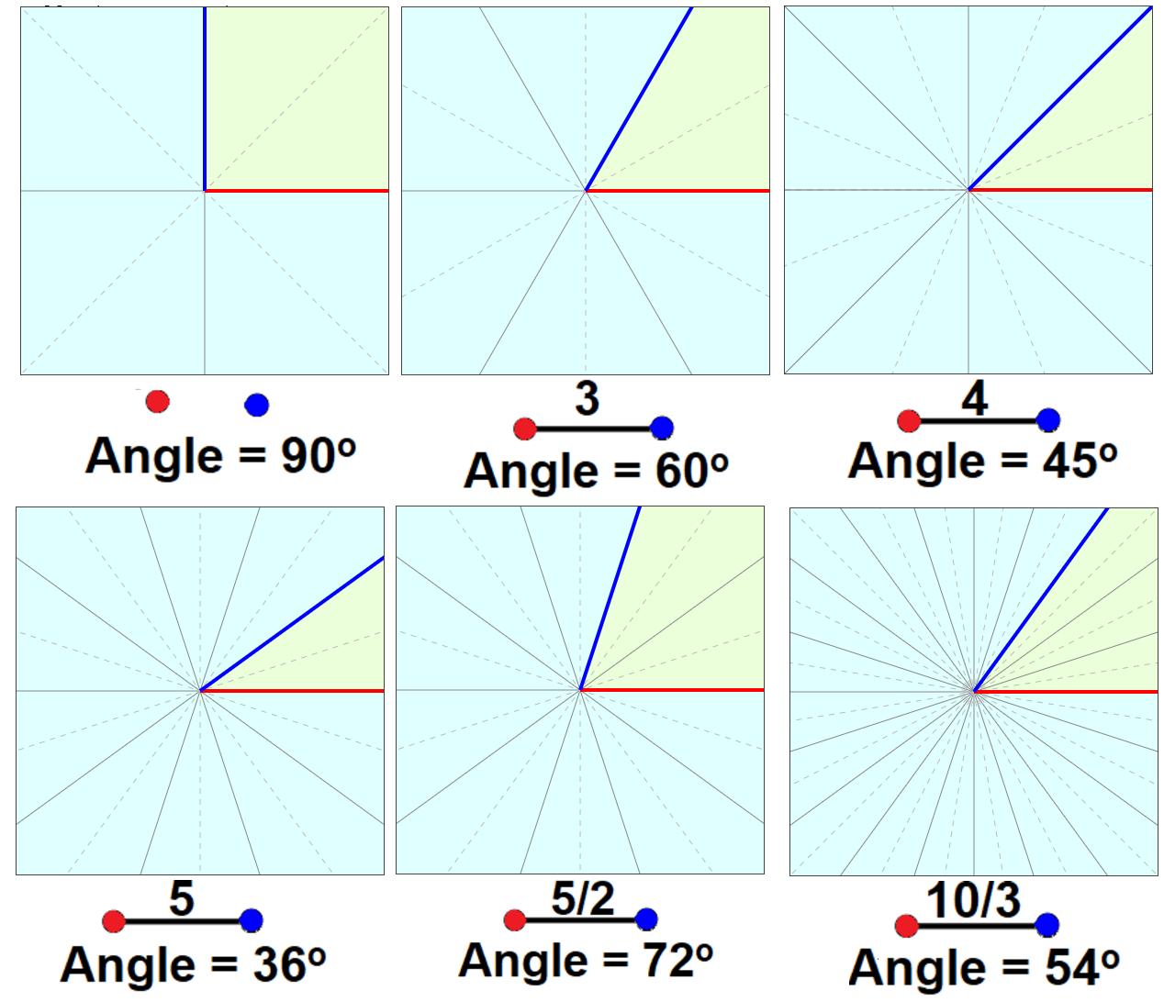
Rank-2 Reflectional Kaleidoscopes – Sector Domains
Rank-2 Coxeter groups can be written in:
Coxeter diagram: O---p---O
Coxeter notation as [p] with branch order
Signature notation ₂(2p)₂ with explicit mirror orders.
Its structure is dihedral group, Dih(p) order 2p.
Wythoff construction (isogonal polygons):
Each node is ringed (active) or unringed (inactive).
Ringed node permutations:
_{<2>}(2p)₂ – first mirror active
₂(2p)_{<2>} – second active (dual)
_{<2>}(2p)_{<2>} – both active (truncation)

Slide 4
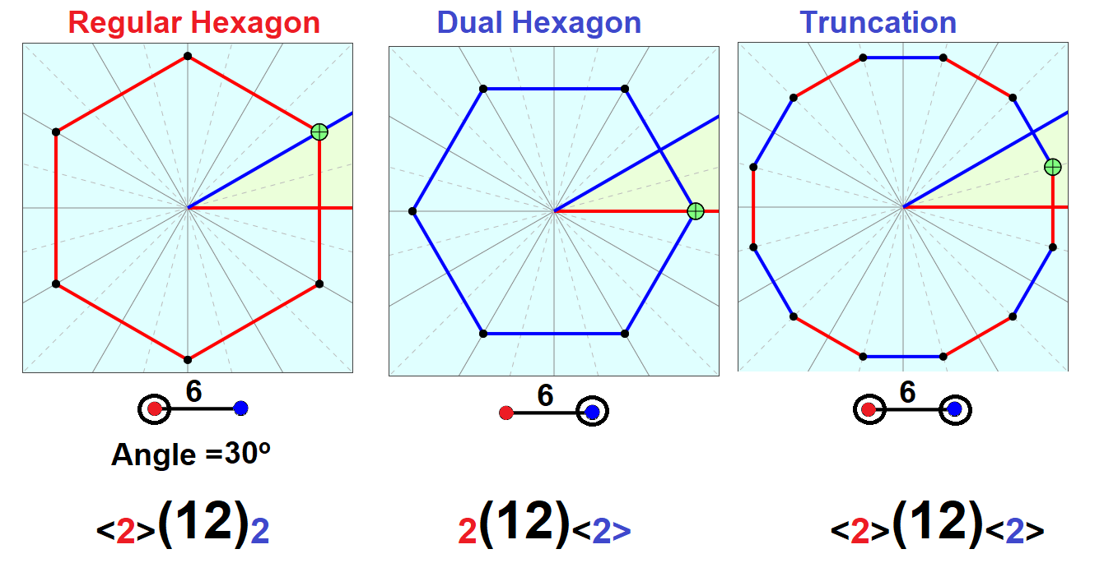
Rank 2 Kaleidoscope: Isogonal Polygons
A Kaleidoscope uses one “seed” point that is reflected across the mirrors.
Coloring mirrors red and blue show a red hexagon, its dual blue hexagon, and a uniform truncation (alternation both red and blue edges.)

Slide 5
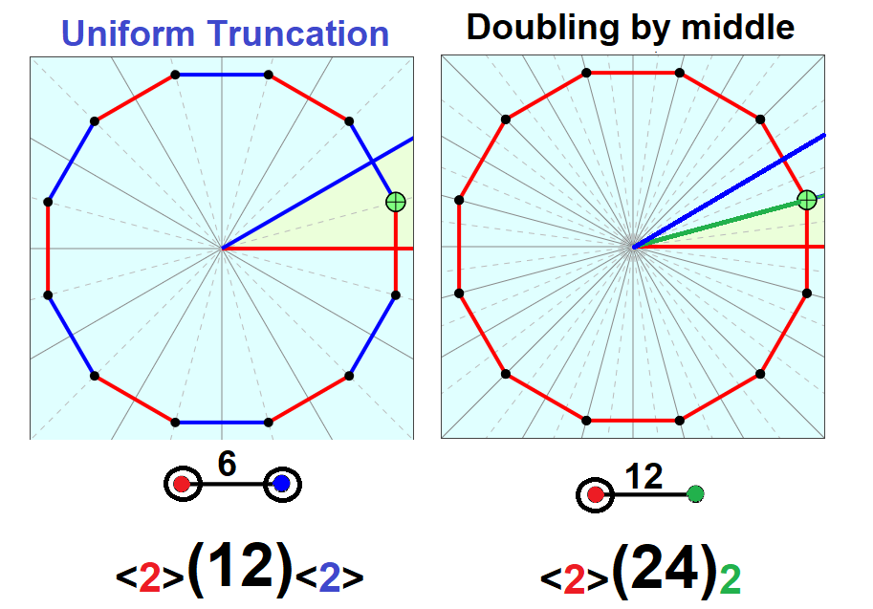
Symmetry Doubling – Fundamental Domain Bisected
If the generator point is exactly between the red and blue mirror (uniform truncation), an inactive (green) mirror can be added on the bisection which maps the red and blue mirrors together.
_{<2>}(2p)_{<2>} = _{<2>}(4p)₂

Slide 6
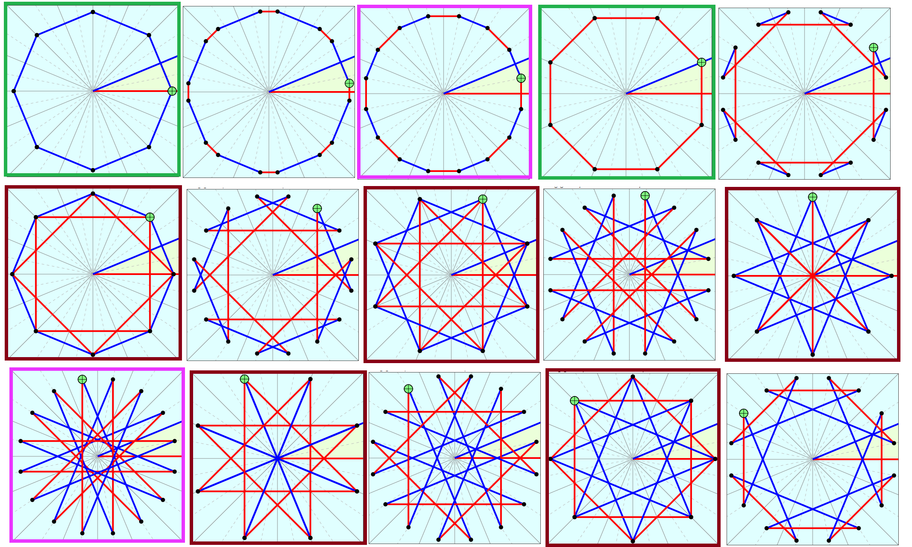
“Anti-truncations” – Seed Outside Fundamental Sector
Examples: [8], _{<2>}(16)_{<2>} Truncated octagons: 0 | 1/2 | 1 | 3/2 | 2 | 5/2 | 3 | 7/2 | 4 | 9/2
Note: Vertices may coincide when seed is positioned on a virtual mirror.

Slide 7
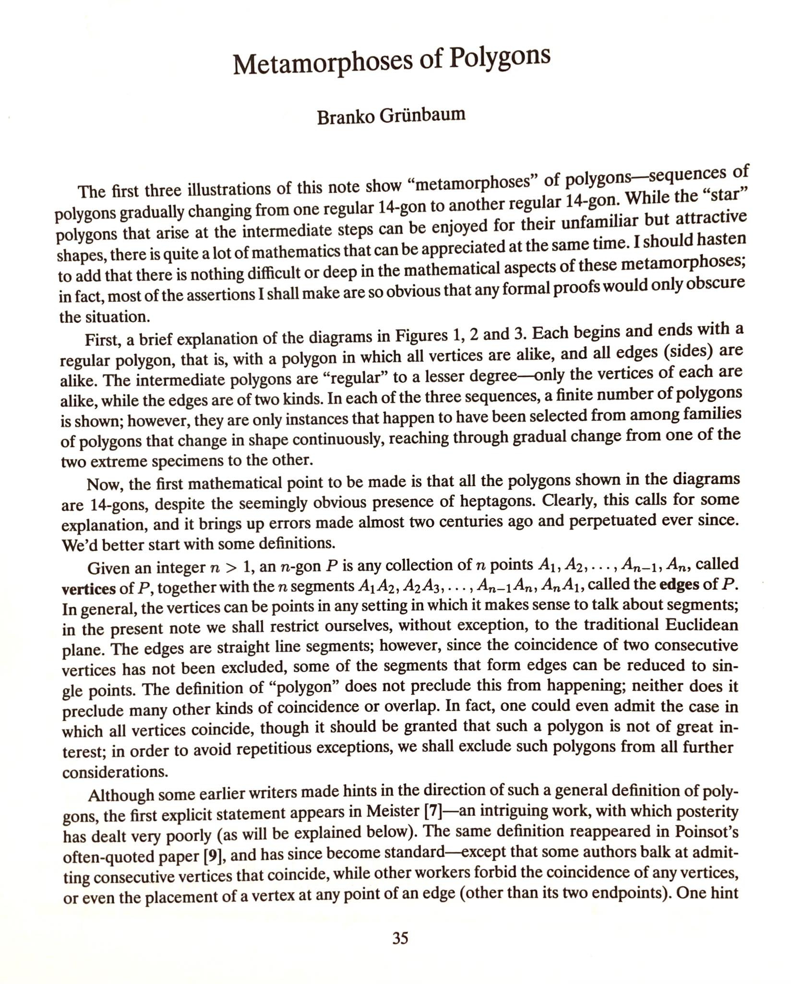
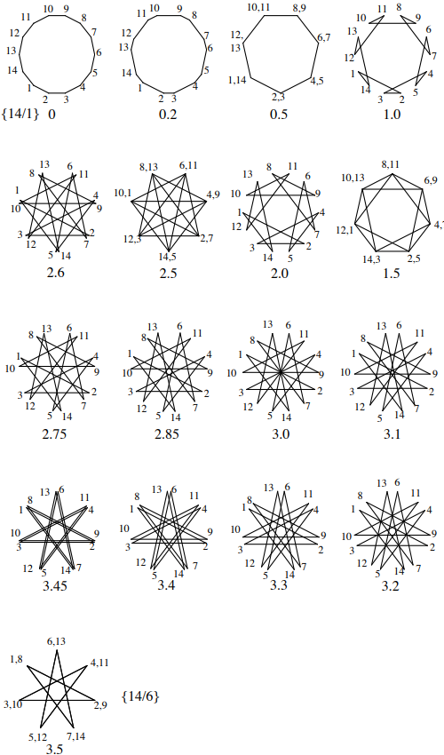
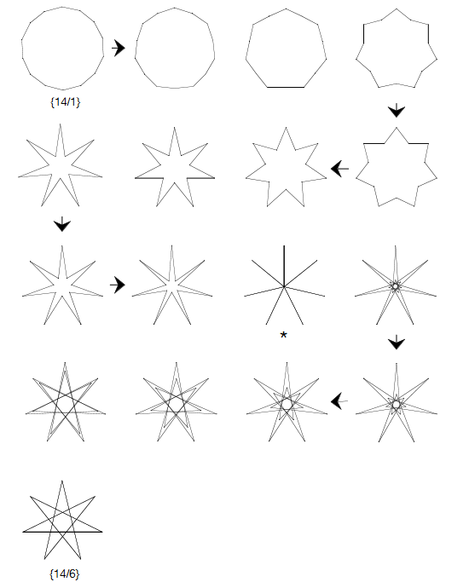
Isogonal / Isotoxal Starry Polygons t’{p/q}
Branko Grünbaum, Metamorphoses of Polygons, The Lighter Side of Mathematics, 1994
Isogonal (vertex-transitive, 2 edge types) polygons and isotoxal (duals, edge-transitive, 2 vertex types)

Slide 8
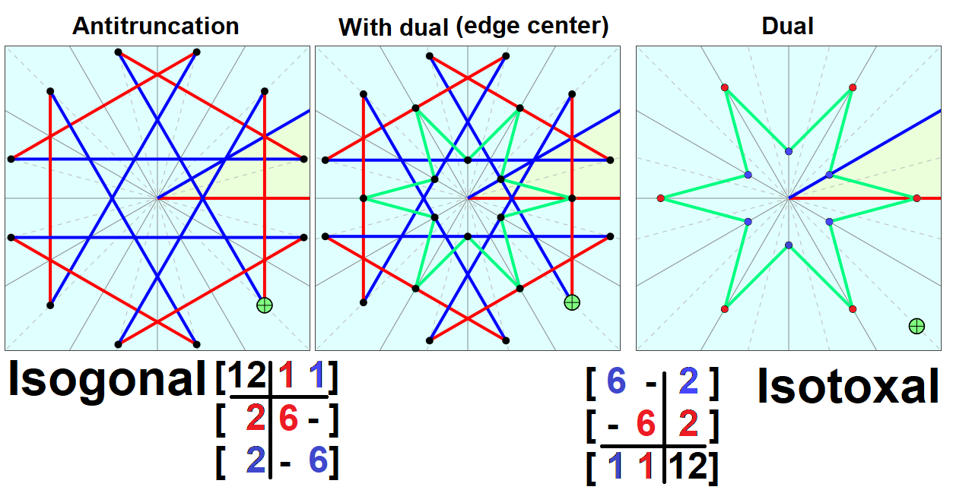
Isotoxal Polygons as Duals of Truncations
(Truncations) Isogonal (vertex-transitive, 2 edge types) polygons, t’{6}
Dual is Isotoxal (edge-transitive, 2 vertex types), dt’{6}
Incidence matrices can show the 2 edge or vertex types in a 3x3 matrix.

Slide 9
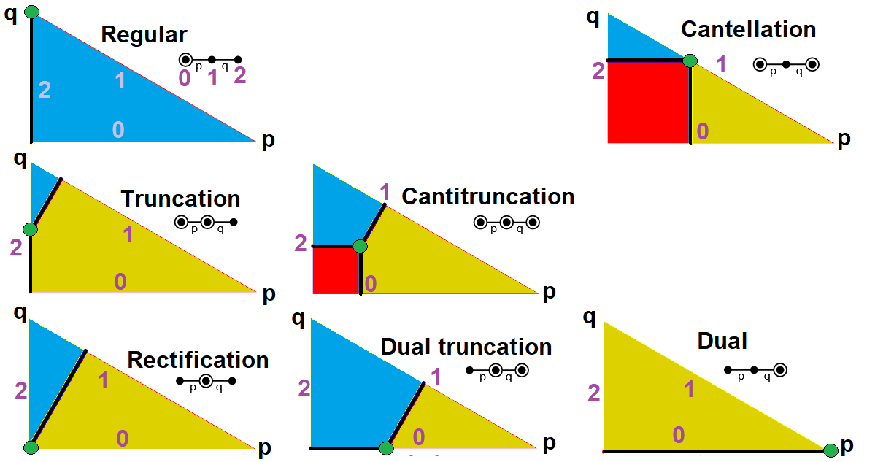
Rank-3 Kaleidoscopic Uniform Constructions
Coxeter diagram: O—p—O—q—O, bracket notation [p,q] and incidence notation ₂(2p)₂(2q)₂.
They are constructed by 3 mirror generators corresponding to the 3 nodes, index {0,1,2}. Finite forms include polyhedral groups [3,3], [3,4], [3,5], 1/p+1/q<1/2. Euclidean forms are [4,4], and [3,6], 1/p+1/q=1/2. Hyperbolic forms include [4,5], [3,7], [5,5], … [p,q] with 1/p+1/q>1/2
There are 7 ring permutations that generate uniform polyhedra or tilings.

Slide 10
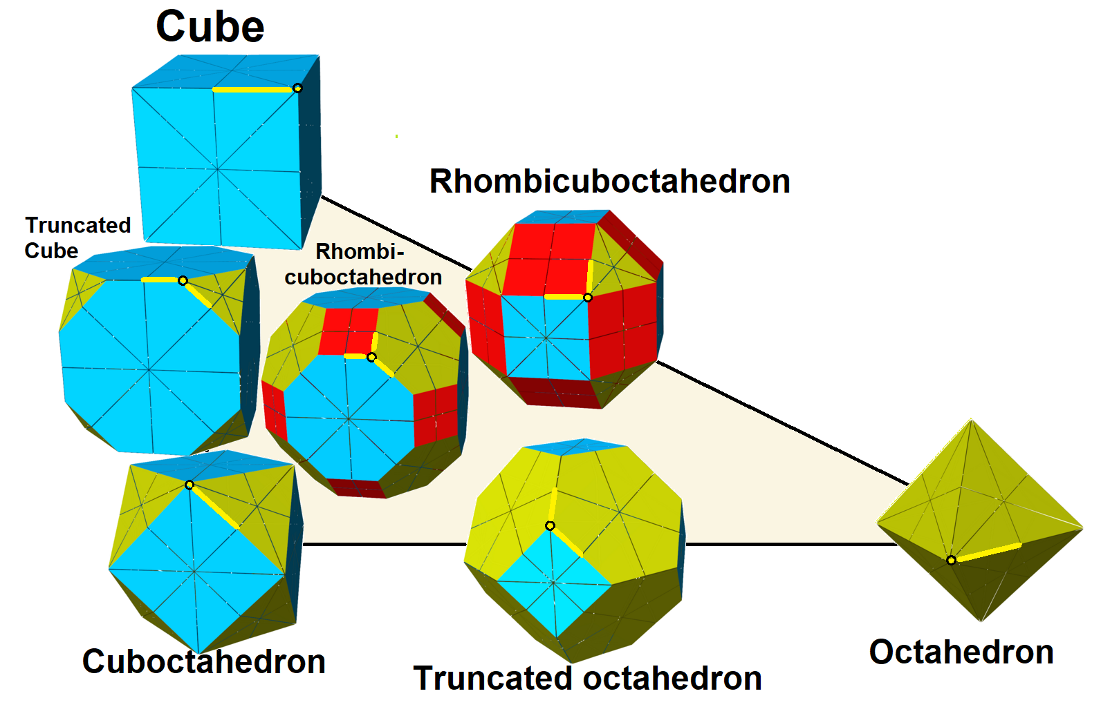
Uniform Polyhedra in Cube/Octahedral Family

Slide 11
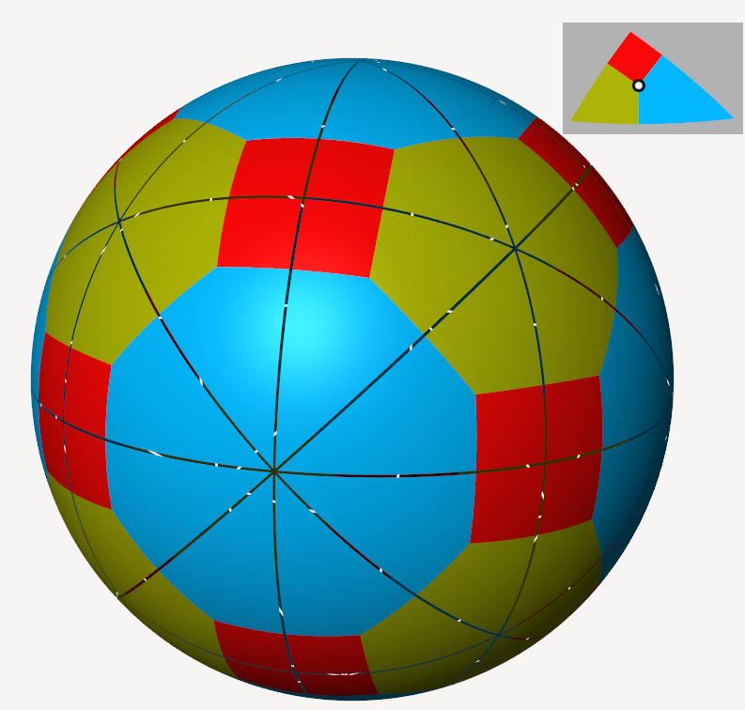
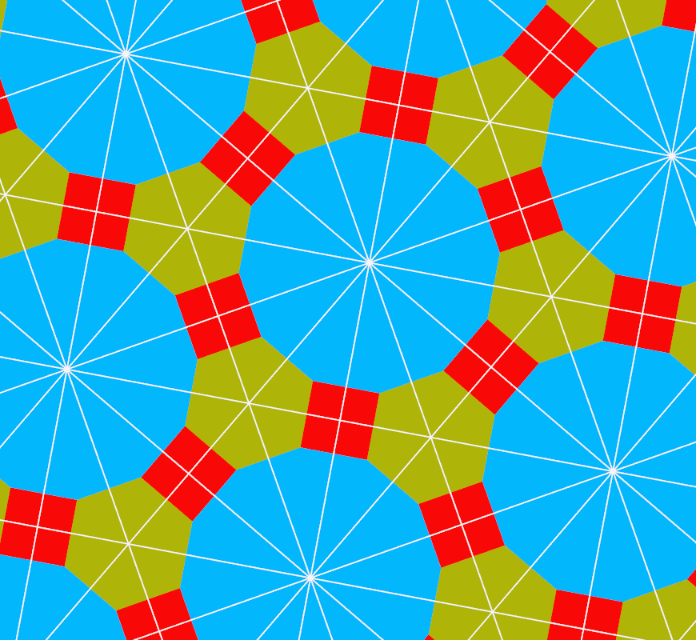
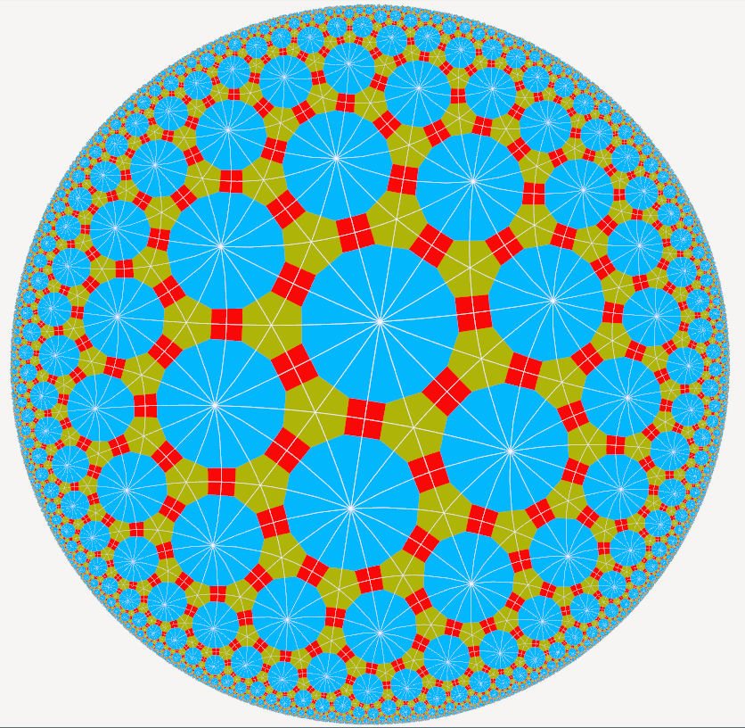
KaleidoTile Software
https://www.geometrygames.org/KaleidoTile
Jeff Weeks’ free educational software allows any (p q r) construction by movable seed point.
Spherical (4 3 2) (polyhedral) Euclidean (6 3 2) Hyperbolic (7 3 2)

Slide 12
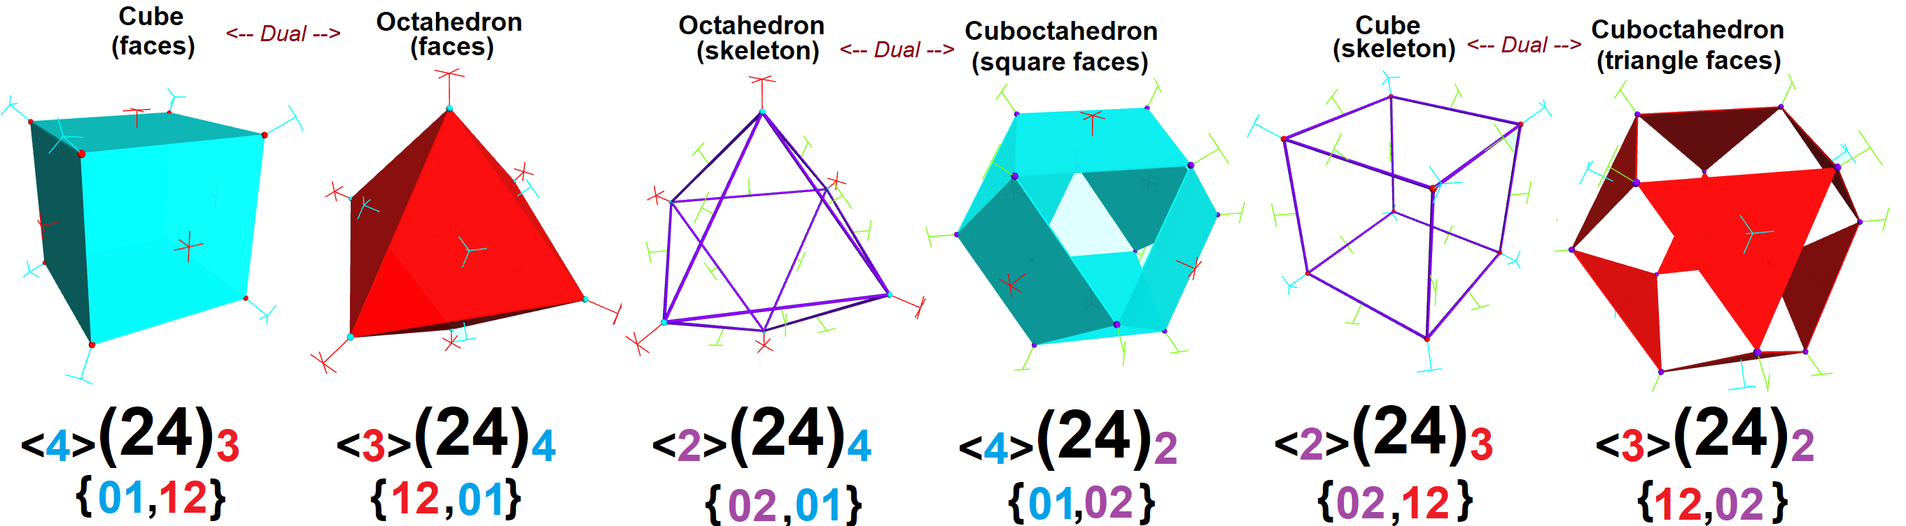
Rotational Generators via 3 Reflections
Rank 3 Coxeter group [p,q], or ₂(2p)₂(2q)₂ has 3 mirror generators indexed {0,1,2}.
The rotational form [p,q]⁺ has 3 rotational generators (p,q,2) represented by mirror products {01,12,02}. Products of two generators produces unneeded third generator.
This allows us to define THREE rank 2 signatures: _{p}(g)_{q}, as well as _{p}(g)₂ and _{q}(g)₂.
Octahedral (cubic) ₂(8)₂(6)₂ has 6 forms: _{<4>}(24)₃ + _{<3>}(24)₄ | _{<2>}(24)₄ + _{<4>}(24)₂ |_{<2>}(24)₃ + _{<3>}(24)₂

Slide 13
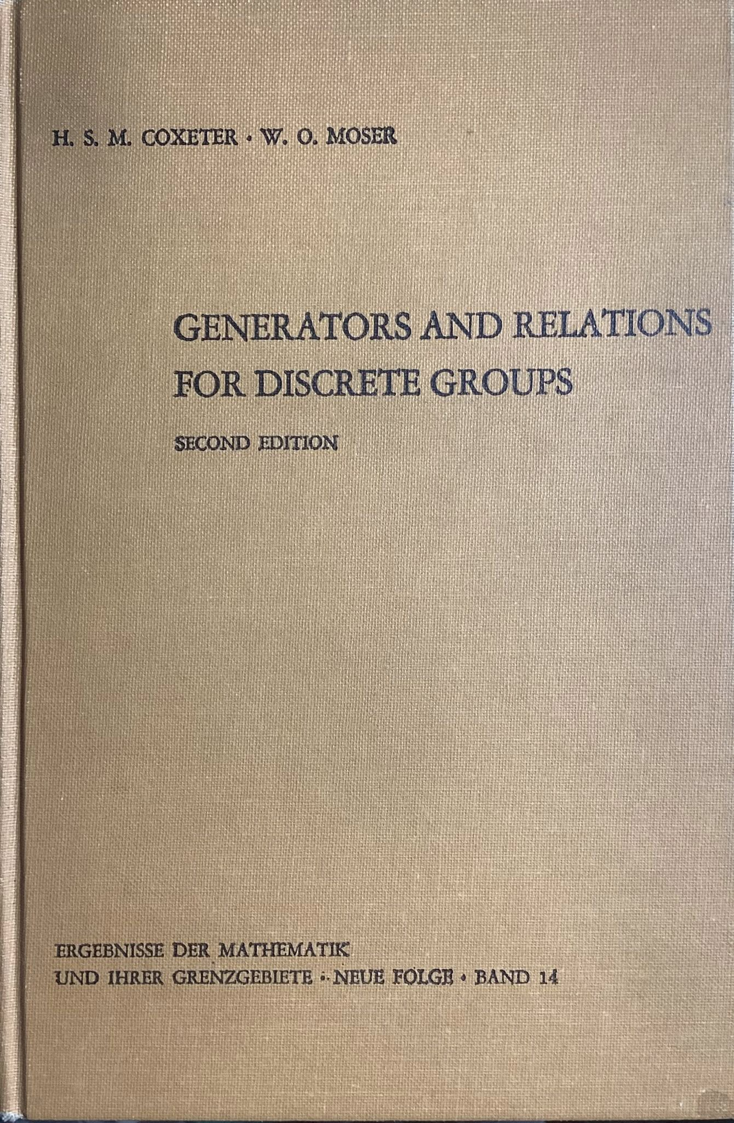
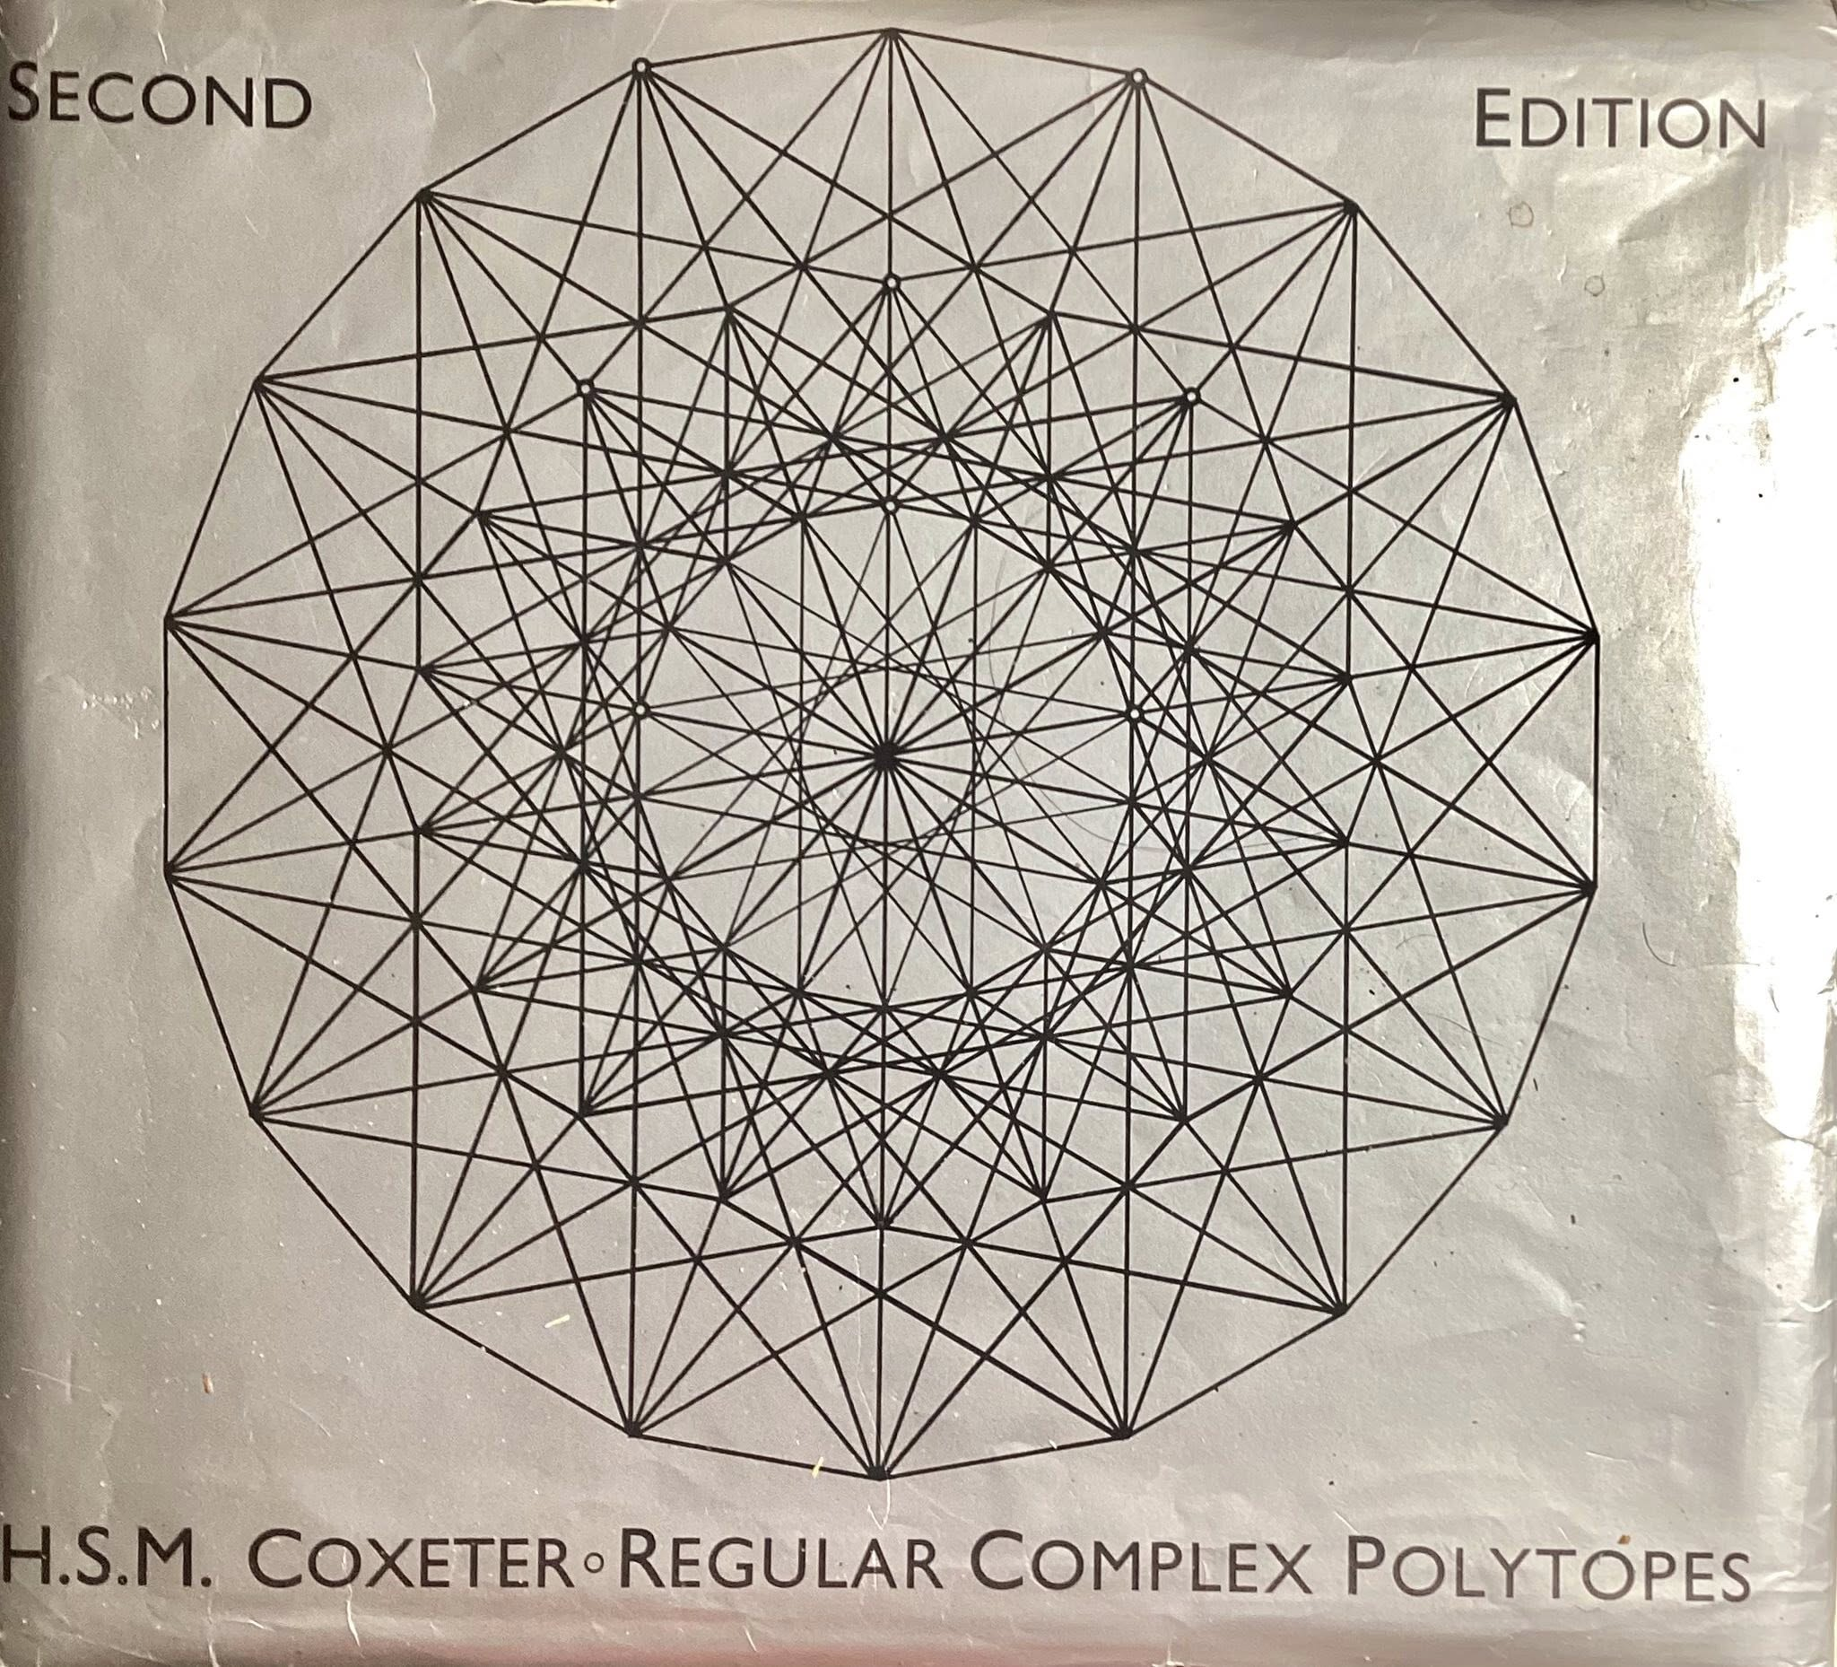
What are these rank-2 signatures? _{p}(g)_{r}
The notation _{p}(g)_{r} come from G. C. Shephard who explored Regular complex polygons in 1952, existing in Complex plane C² or Real R⁴.
Generators are unitary rotations {R,S} with R^{p} = S^{r} = I.
The polygon _{p}(g)_{r} has g/p edges, and g/r vertices.
The dual _{r}(g)_{p} has g/r edges, and g/p vertices.
Coxeter notation p[q]r, polygon p{q}r, with theory to match with Coxeter group [q] = ₂[q]₂, and polygon {q} = ₂{q}₂.
g=2h²/q, with 2/h = 1/p + 1/r +2/q -1.
See
Generators and Relation for Discrete Groups, Coxeter and Moser, 1966
Regular Complex Polygons, Coxeter, 1991

Slide 14
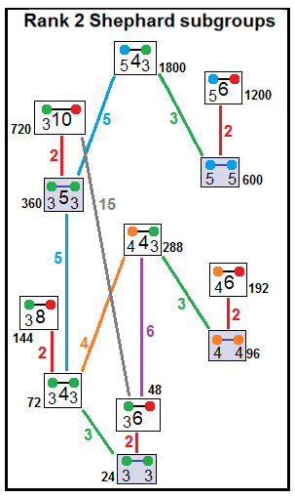
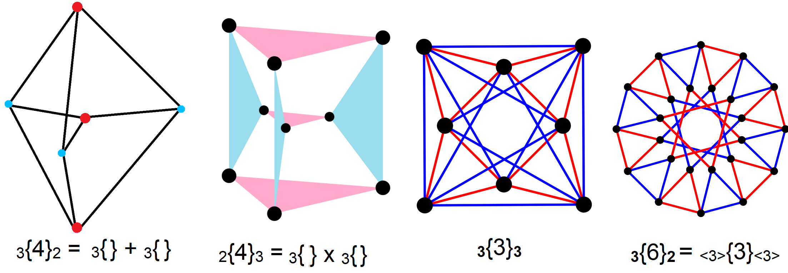
Regular Complex Polygons
There are 22 forms of regular complex polygons, 8 dual pairs and 6 self-dual (1 real):
_{m}{4}₂ + ₂{4}_{m}, ₃{6}₂ + ₂{6}₃, ₃{8}₂ + ₂{8}₃, ₄{6}₂ + ₂{6}₄, ₄{4}₃ + ₃{4}₄, ₃{10}₂ + ₂{10}₃, ₅{6}₂ + ₂{6}₅, ₅{4}₃ + ₃{4}₅, ₃{4}₃, ₃{3}₃, ₄{3}₄, ₅{3}₅, ₃{5}₃, and real ₂{m}₂.
Self-dual forms _{p}{q}_{p} allow odd q, just like real ₂{q}₂ as double covering of generators.

Slide 15
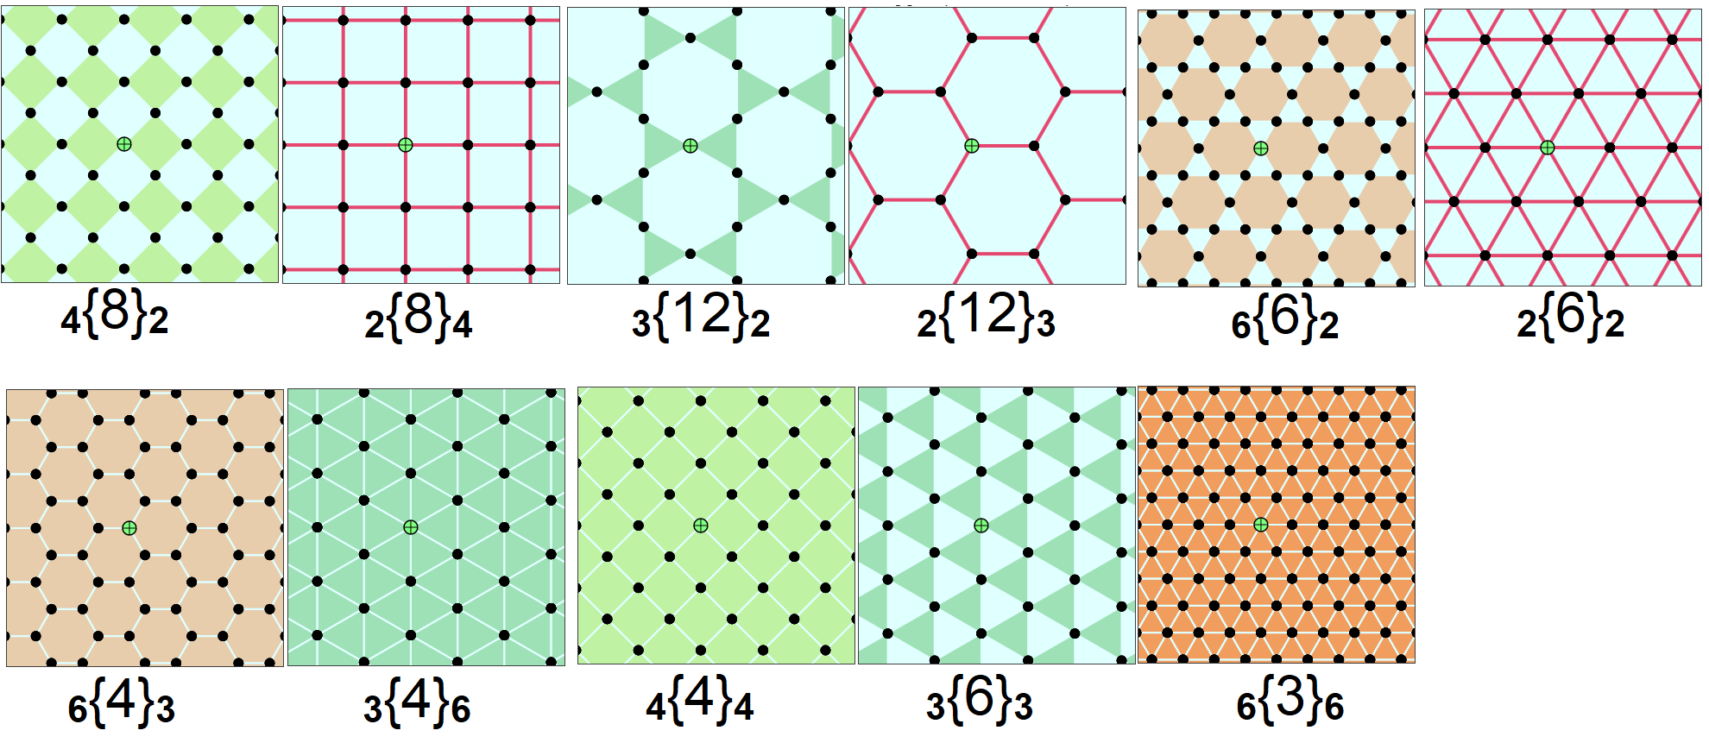
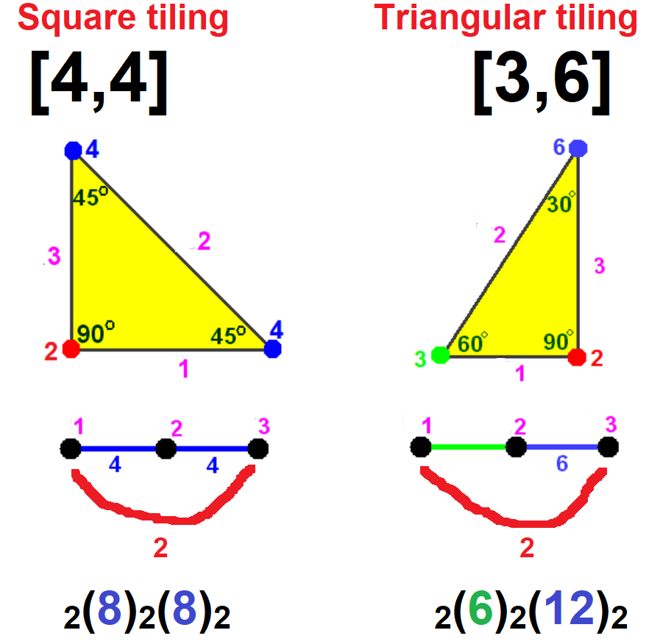
Regular Complex Apeirogons
Complex polygons become infinite, spanning C¹ or R² with: 1/p + 1/r +2/q = 1.
There are 11 forms of regular complex apeirogons in 4 dual pairs and 3 self-duals: ₄{8}₂ + ₂{8}₄, ₃{12}₂ + ₂{12}₃, ₆{6}₂ + ₂{6}₆, ₆{4}₃ + ₃{4}₆, ₄{4}₄, ₃{6}₃, and ₆{3}₆.
All can be constructed in R² within [4,4] and [3,6], square and tri/hexagonal tilings.

Slide 16
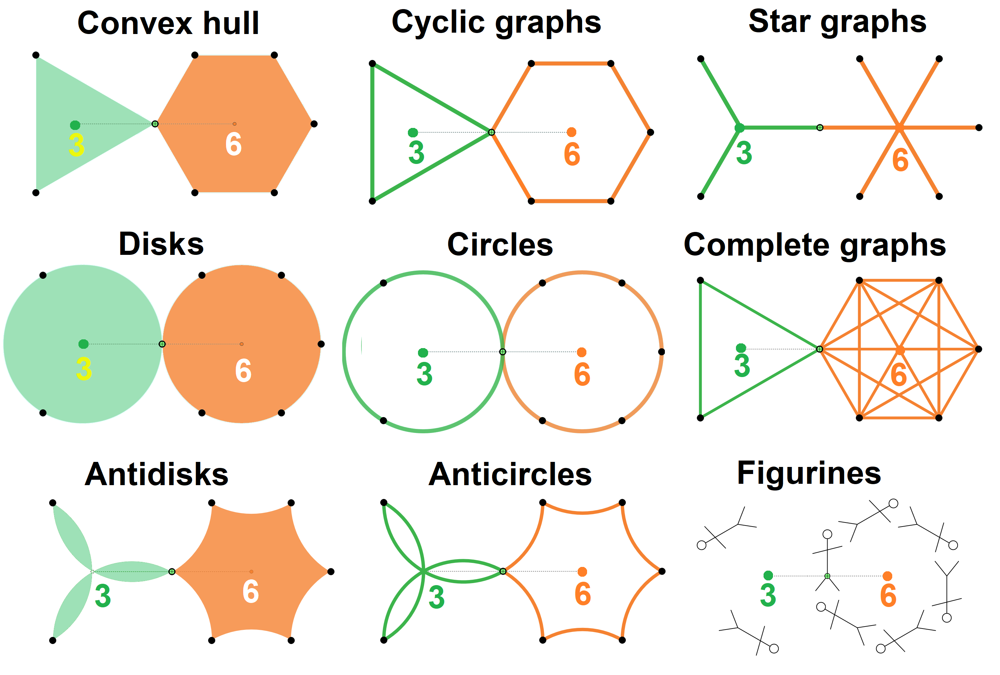
Varied Presentations of Rotational Edges
Rotational edges and have no correct representation.
Options:
Interior area or perimeter
Star graphs with center
Complete graphs
Disks or Circles
Anti-disks or Anti-circles
Vertices can be represented by extended “figurines” that rotate and translate with seed.
Examples show for ₃{4}₆ primary generators.

Slide 17
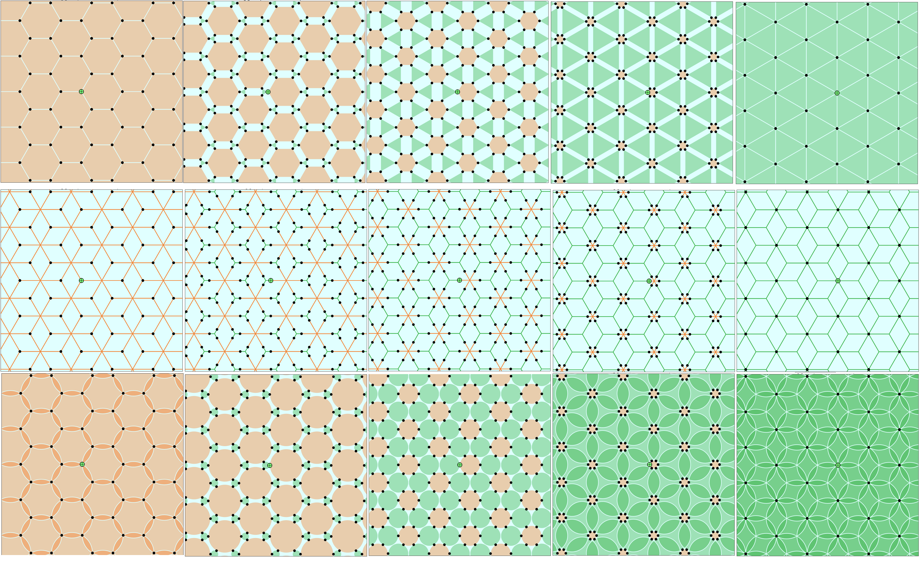
Truncations of Complex Apeirogons
Truncations in 5 steps from _{<6>}{4}₃ to _{<6>}{4}_{<3>} to dual ₆{4}_{<3>}.
3 rows representations as convex hull, star graphs and disks.

Slide 18
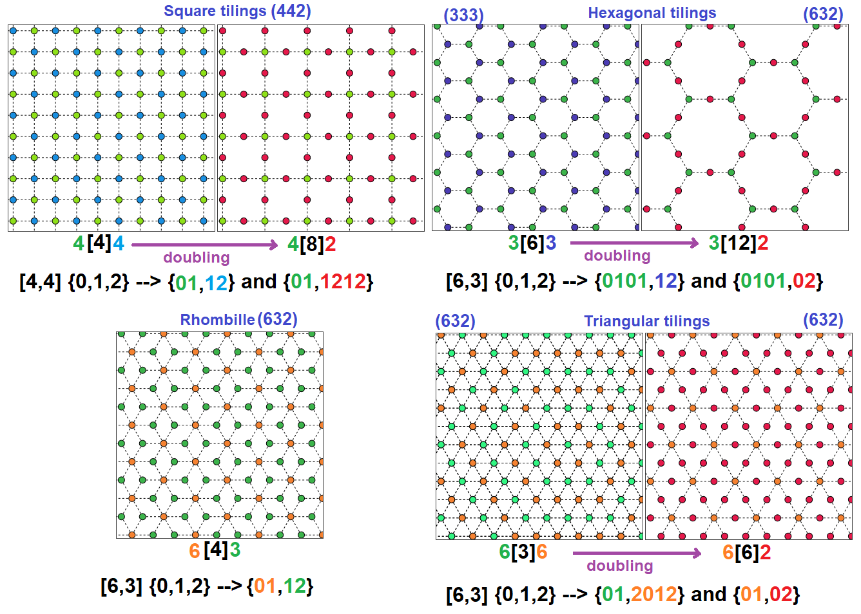
Dual of Truncations are Isotoxal Apeirogons
The dual of an isogonal complex apeirogon is isotoxal (edge-transitive), the Levi graph of regular forms.
Vertices are rotation centers connected by simple edges. Self-dual forms can double _{<p>}{q}_{<p>} = _{p}{2q}₂.

Slide 19
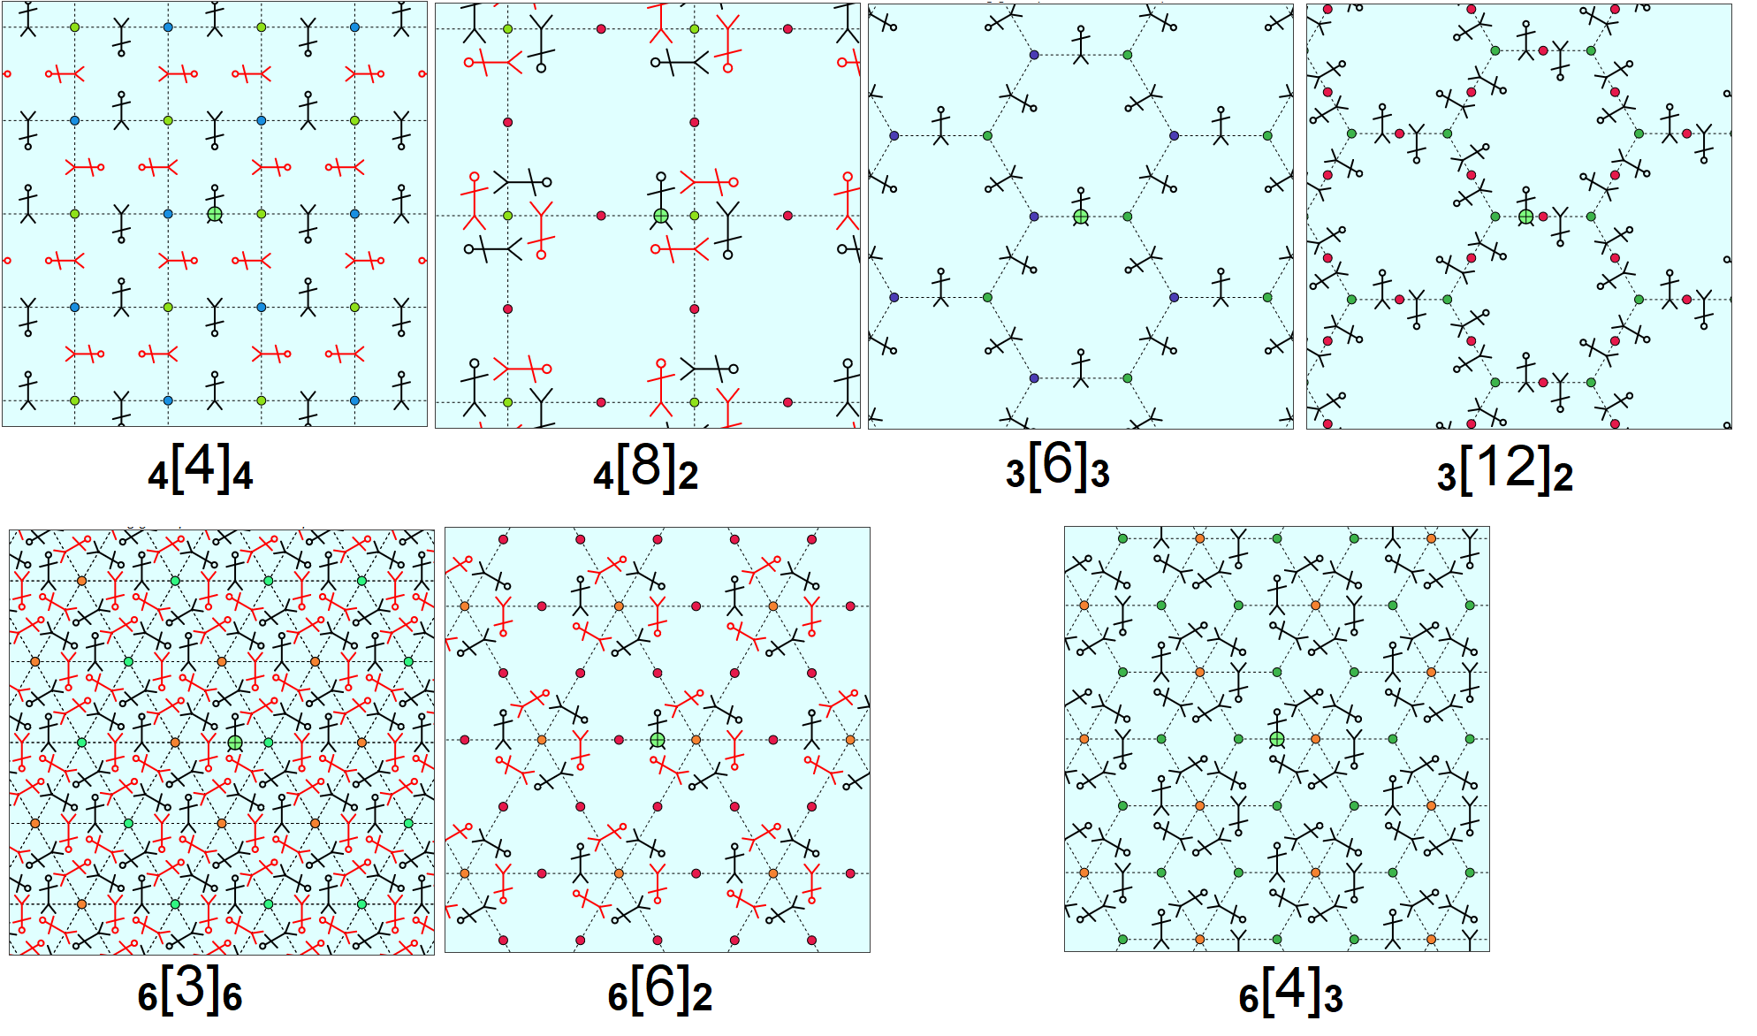
Rotational Stick Figures
We can position stick figures at vertices who rotation with generators.
For _{p}[q]_{r} cases where p,r both even, we can globally color red/black by parity.

Slide 20
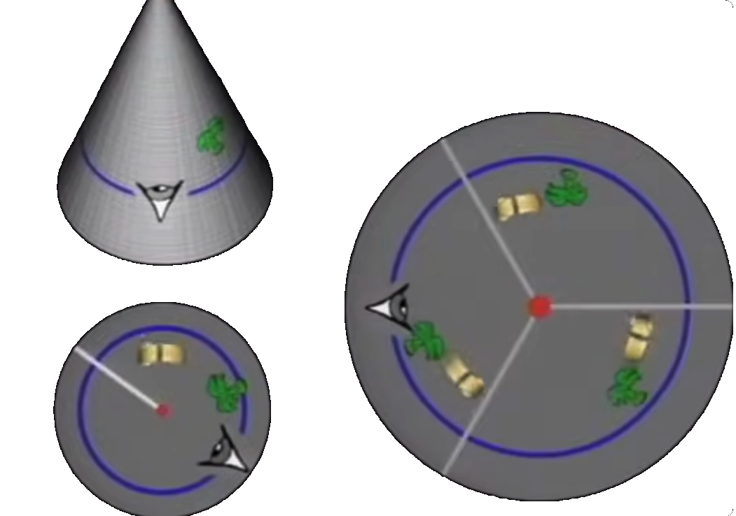
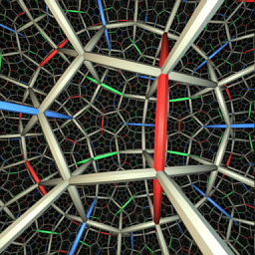
Cone Points– sector repeated by rotation
Not Knot, Geometry Center, University of Minnesota, 1991 https://youtu.be/QcLfb0PhfO0?t=338

Slide 21
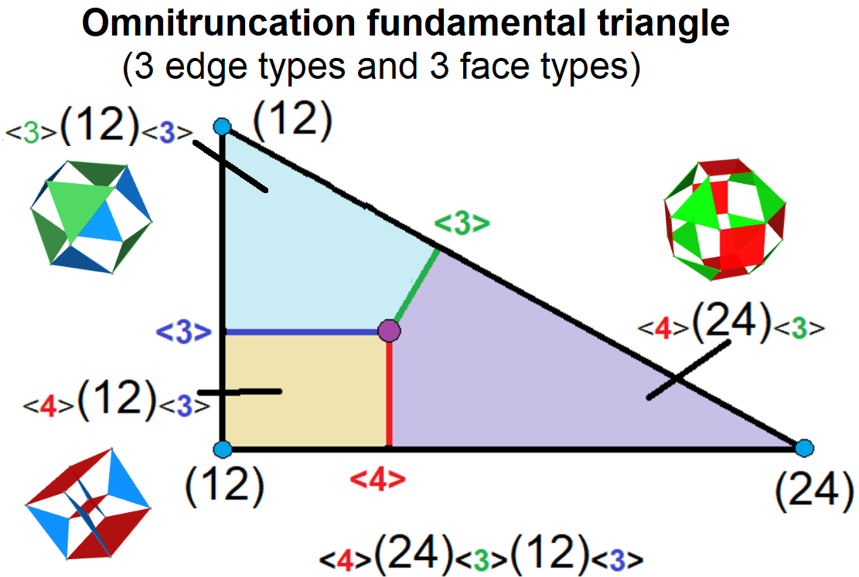
Rank-3 Rotational Generators (future)
Tesseract incidence: [16 4 6 4] [ 2 32 3 3] [ 4 4 24 2] [16 4] [ 8 12 6 8] [ 8 8]
Cell-Vertex Signature _{<8>}(64)₄ Facet (cube) and Vertex figure (tetrahedron)
[8 3 3] [4 3 3]
[2 12 2] [2 6 2] [8 3] [4 3]
[4 4 6] [3 3 4] [4 6] [3 4]
Face-Vertex Signature _{<4>}(24)₃(12)₃
Mirror generators: {0,1,2,3}, Rotations {01,12,23}

Slide 22
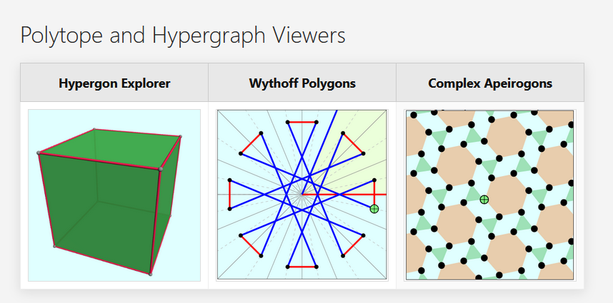
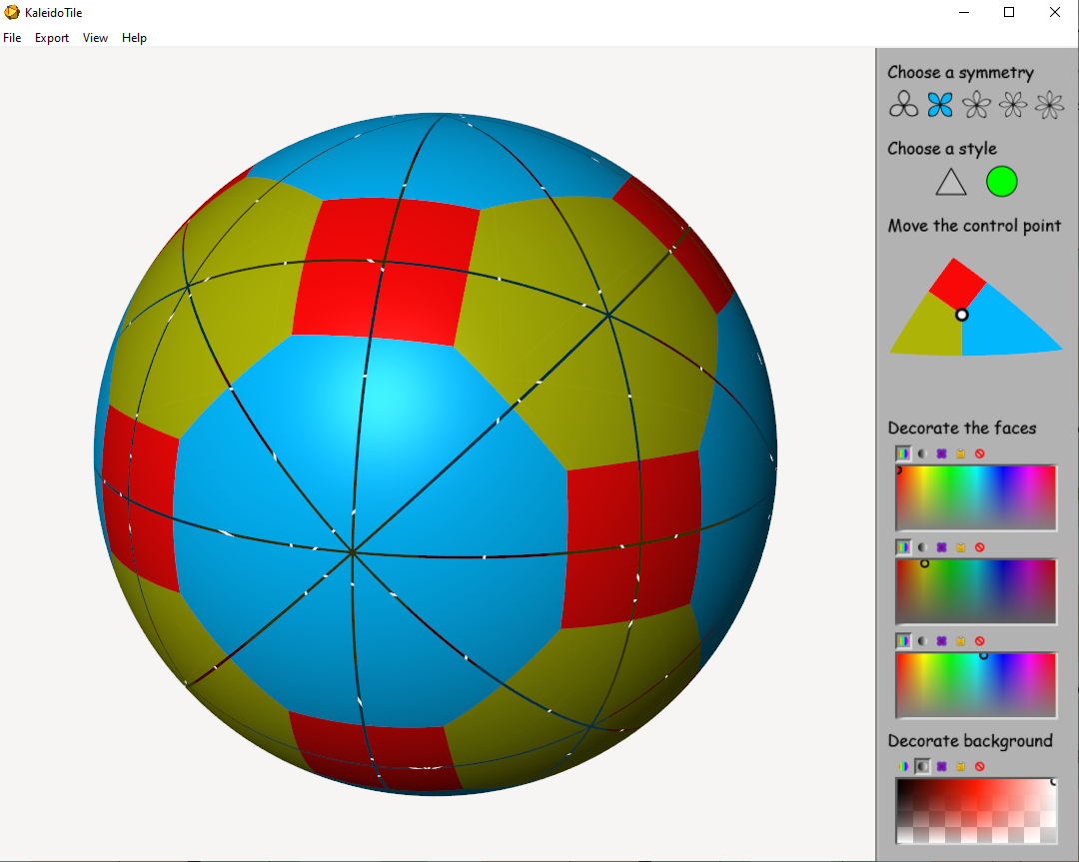
Apps online
Tom Ruen Jeff Weeks hypergons.web.app www.geometrygames.org/KaleidoTile

