Slide 1
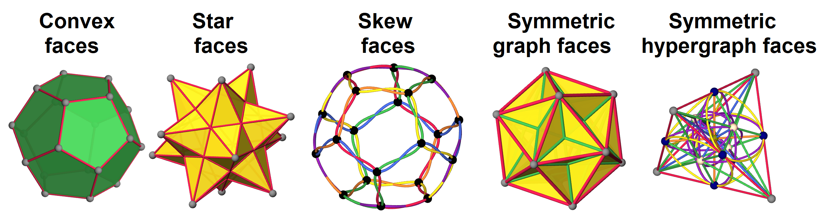
Regular Polygons and Polyhedra of the Fourth Kind MAA NCS/MinnMATYC Fall 2025 meeting, October 11, 2025 Tom Ruen, Email: tomruen@gmail.com, Web: http://roice3.org/ruen/
Abstract: Regular polyhedra exhibit transitivity across vertices, edges, and faces, bounded by regular faces and vertex figures. They occur in dual pairs, unless self-dual. Classical families include Platonic solids with regular convex faces (1st kind), Kepler–Poinsot polyhedra with regular star faces (2nd kind), and Petrie–Coxeter with regular skew faces (3rd kind). We propose a 4th kind, allowing faces and vertex figures to be symmetric graphs. Examples include polyhedra with faces isomorphic to K₄ (skeletal 3-simplex), K₅ (skeletal 4-simplex), K₂,₂,₂ (skeletal octahedron), and 2C₃ (star of David). We survey symmetric graphs up to 15 vertices as candidate faces for future regular polyhedra.

Slide 2
Regular polygons and polyhedra of the 4th kind!
Regular polyhedra of nth kind have nth kind of regular faces and vertex figure.
Allow regular convex faces and verfs
5 Platonic {3,p}, {p,3}, with p=3,4,5
Allow regular star faces and verfs
4 Kepler-Poinsots {5/2,p}, {p,5/2}, p=3,5
Allow regular skew faces or verfs
(a) Petrie infinite polyhedra (skew verfs): {4,6|4}, {6,4|4}, {6,6|3}
(b) Petrial regulars (skew faces): {3,p}_{π}, {p,3}_{π} {5/2,p}_{π} {p,5/2,p}_{π} with p=3,4,5
Allow symmetric graph faces and verfs
Yet unexplored polyhedra!
Allow symmetric hypergraphs faces and verfs
(a) Regular complex polygons in C² (~R⁴) and complex polyhedra in C³ (~R⁶).
(b) Projective geometries PG(3,k) and point-line-plane configurations

Slide 3
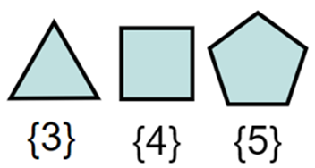
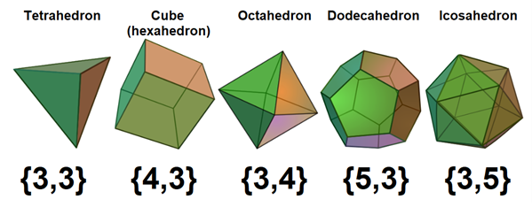
First Kind: Platonic solids
Named by Kepler after Plato (~400 BC) who associated with: fire, earth, air, water, and aether.
Triangles, squares and pentagons fit in a cyclic path around a vertex in 5 ways.
Schläfli symbol {p, q} means wrap q p-gons around a vertex.
The q-gon is a “vertex figure”, the cyclic path of neighboring vertices.
{3, 3} is self-dual. {3, p} and {p, 3} are duals, p=4, 5.

Slide 4
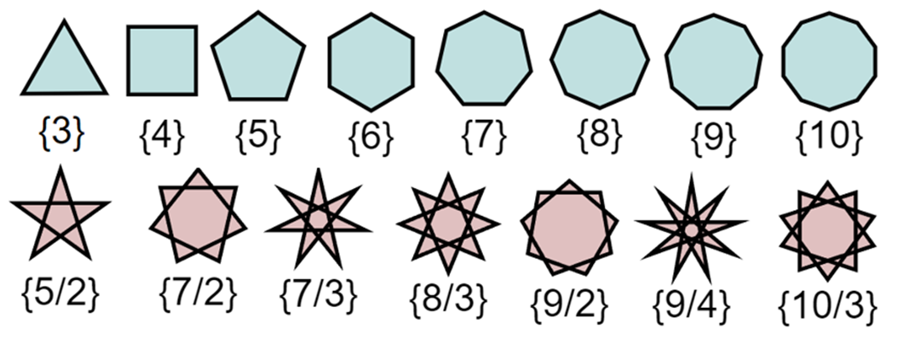
Regular polygons of the first and second kind
(First) Regular convex polygons, {p}, have p equal vertices and edges, p=3,4,5,…
(Second) Regular star polygons {p/q} have p vertices, edges, step q, gcd{p,q}=1
The q is also called the density, times the edge path wraps around.
Only the pentagram, {5/2} exists in regular polyhedra…

Slide 5
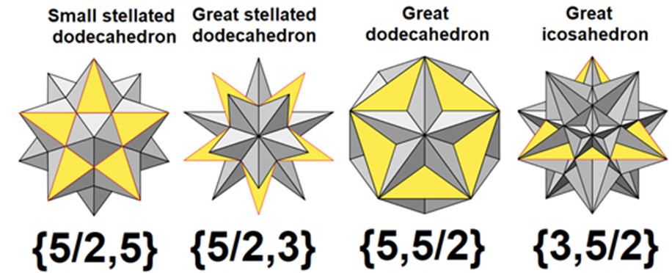
Second Kind: Kepler-Poinsot
Johannes Kepler identified in 1609, Harmonice Mundi
Louis Poinsot rediscovered and formalized in 1809.
One face is colored yellow for clarity

Slide 6
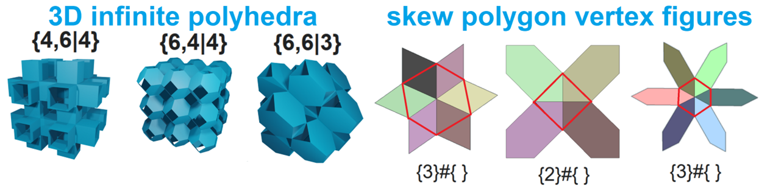
Third Kind (a): Skew vertex figures
Donald Coxeter named these infinite regular polyhedra after John Flinders Petrie who in 1926 found regular faces (squares and hexagons) fit in 3D in regular skew vertex figures. {p, 2q| h} has 2q p-gons zig-zagging, {q}#{ }, h-gonal hole cycles.

Slide 7
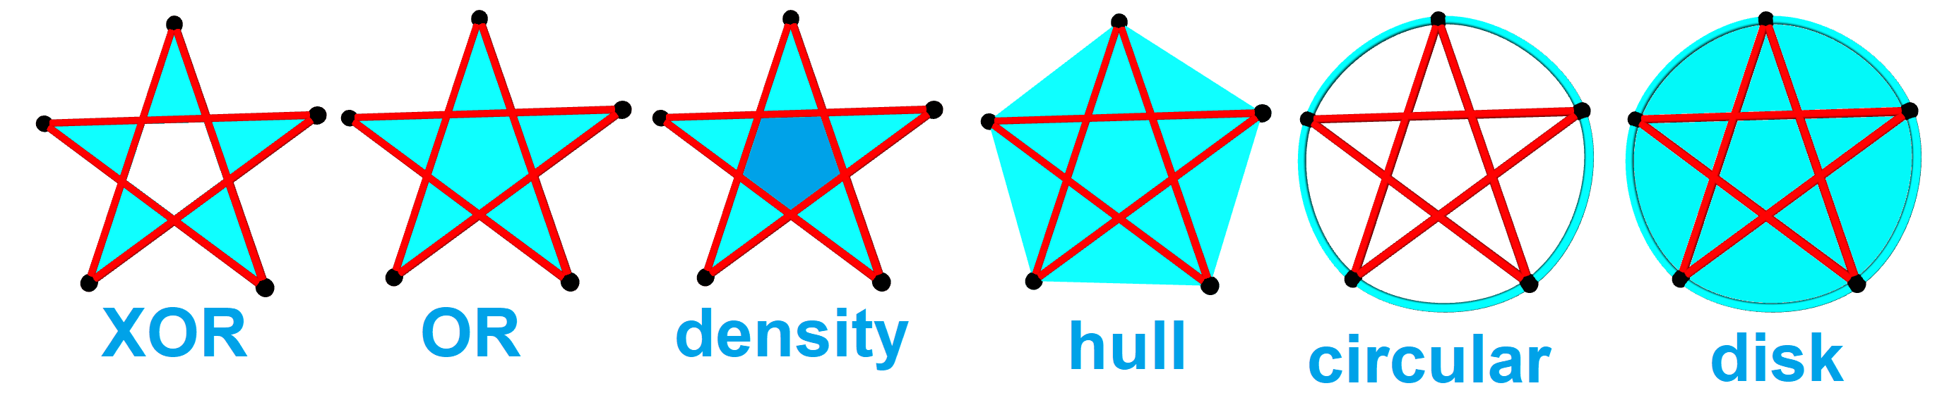
Detour: Polygon interiors
Convex polygons have clear interiors. Star polygons are topological, not bounding space.
Representations
Fill by edge crossings: logical XOR, OR, density count
Convex hulls – polygonal interior, circular, disk interior

Slide 8
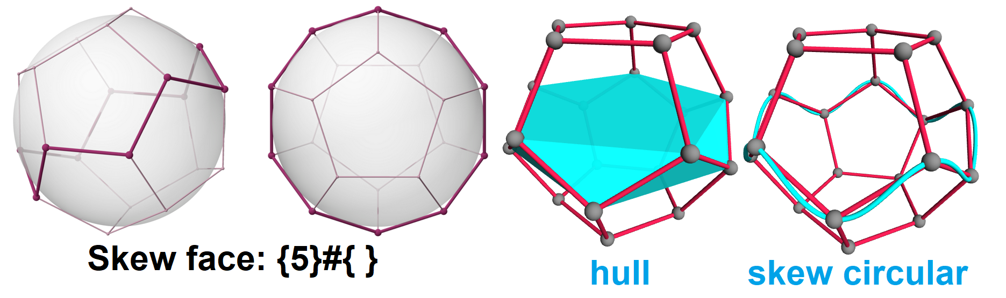
Third Kind (b): skew faces - Petrial Platonics
A petrial polyhedron uses skeleton of a regular polyhedron and connects faces as regular skew polygons.
Dodecahedral petrial {5,3} _{π} has central skew decagon faces: {5}#{ }.
Drawing “interior” of skew decagon by convex hull or a skew circle.

Slide 9
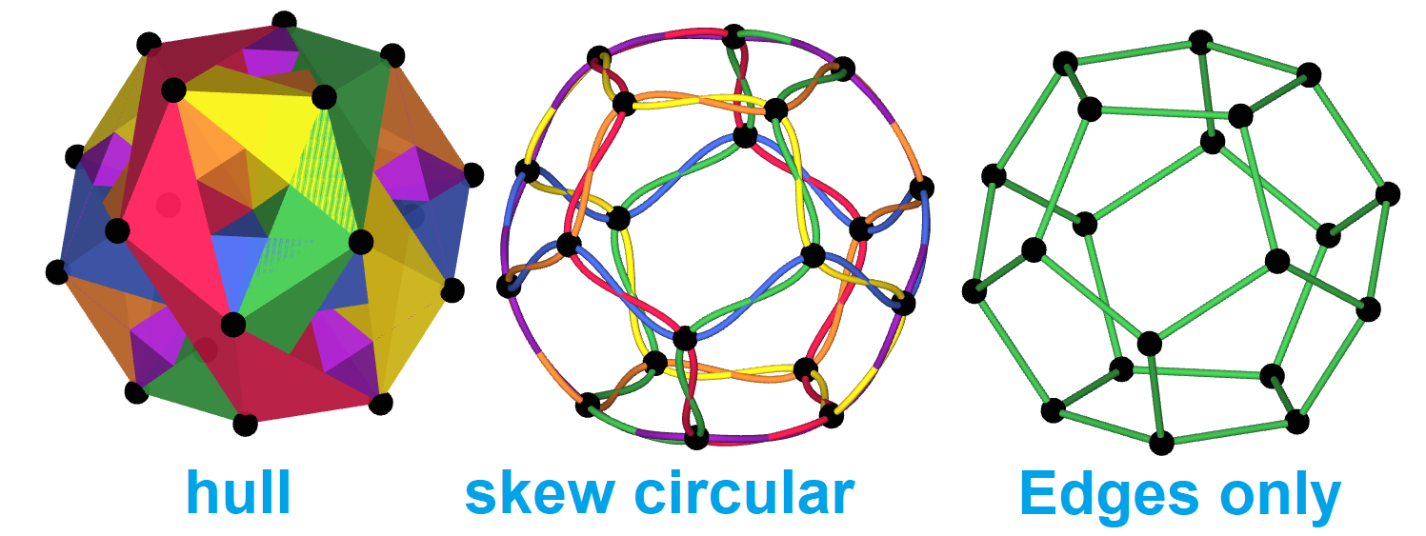
Third Kind (b): skew faces
The petrial dodecahedron has the 20 vertices, and 30 edges of dodecahedron, but only 6 faces as skew decagons.
Hull render shows as interpenetrating pentagonal antiprisms
Skew circular better shows 6 colored paths, 2 faces paths per edge.

Slide 10
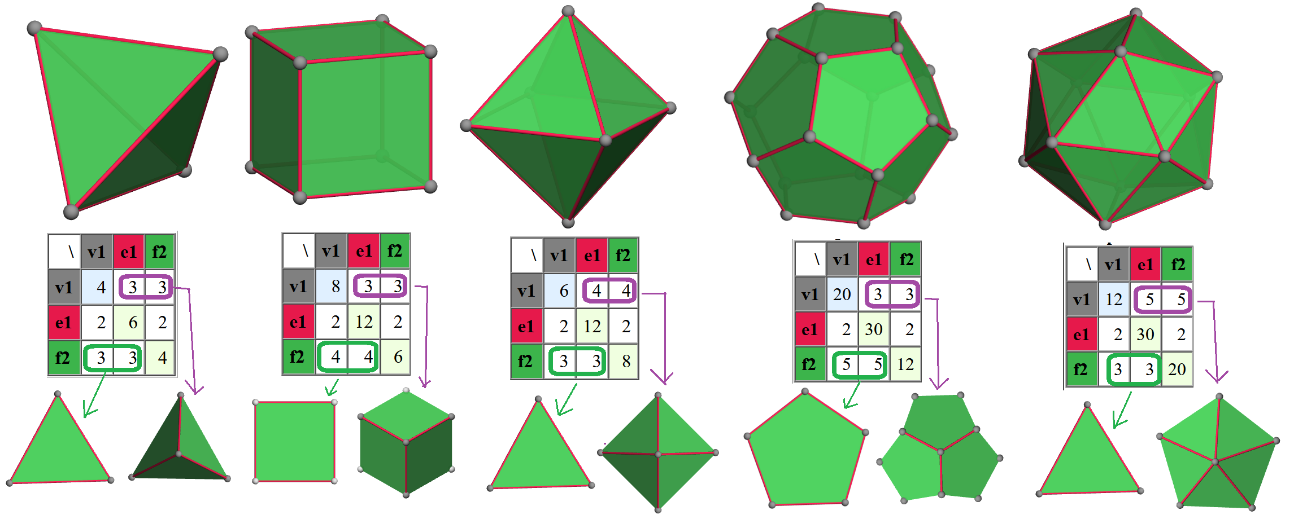
Detour: Configuration matrix
A configuration matrix for polyhedron counts vertices, edges, and faces on the diagonal and incidences off diagonal.
Lower left counts vertices and edges of faces. Upper right on vertex figure.

Slide 11
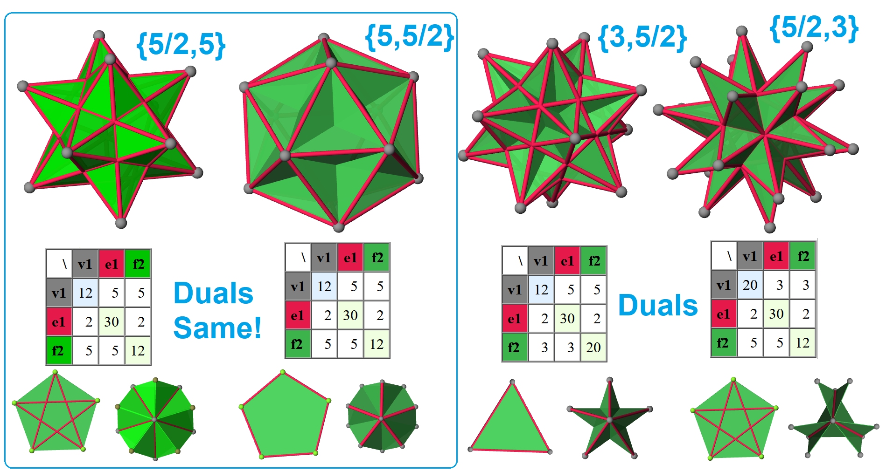
Configurations of Kepler-Poinsot
{5/2,5} and {5,5/2} have identical configuration matrices
Since pentagon {5} and pentagram {5/2} same structure!
Same 12 vertices, same 12 face planes, different 30 edges.

Slide 12
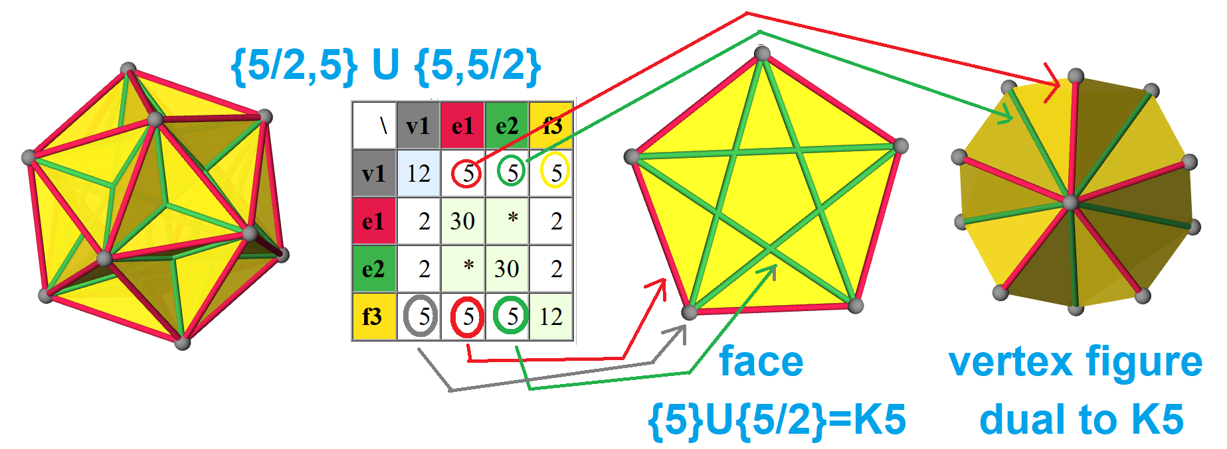
A polyhedron of 4th kind!
Union of {5/2,5} and {5,5/2} gives us {K₅,K₅}?
Each “pentagonal” face is a complete graph, K₅!
Edges (red/green) different length, but abstractly transitive, symmetry double to 240.
Full symmetry can be expressed in 6-dimension on 6-orthoplex, 4-simplex “faces”

Slide 13
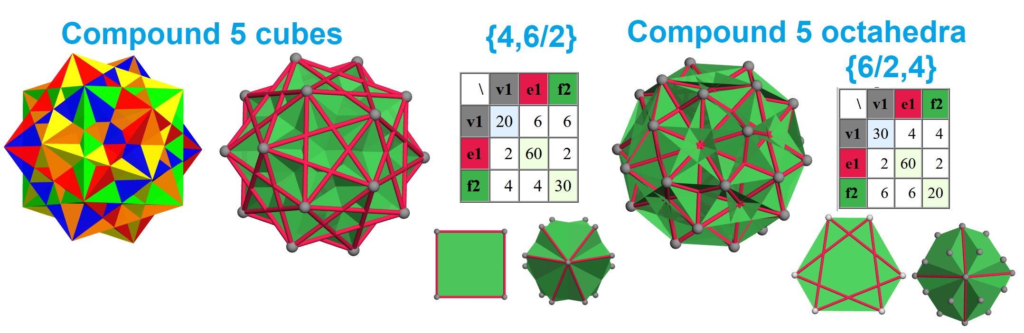
Other examples?
A compound of 5 cubes exist on 20 vertices of dodecahedron.
It can be interpreted as a polyhedron with square faces and a double triangle vertex figure. {4,6/2}
Its dual, compound of 5 octahedra as {6/2,4}

Slide 14
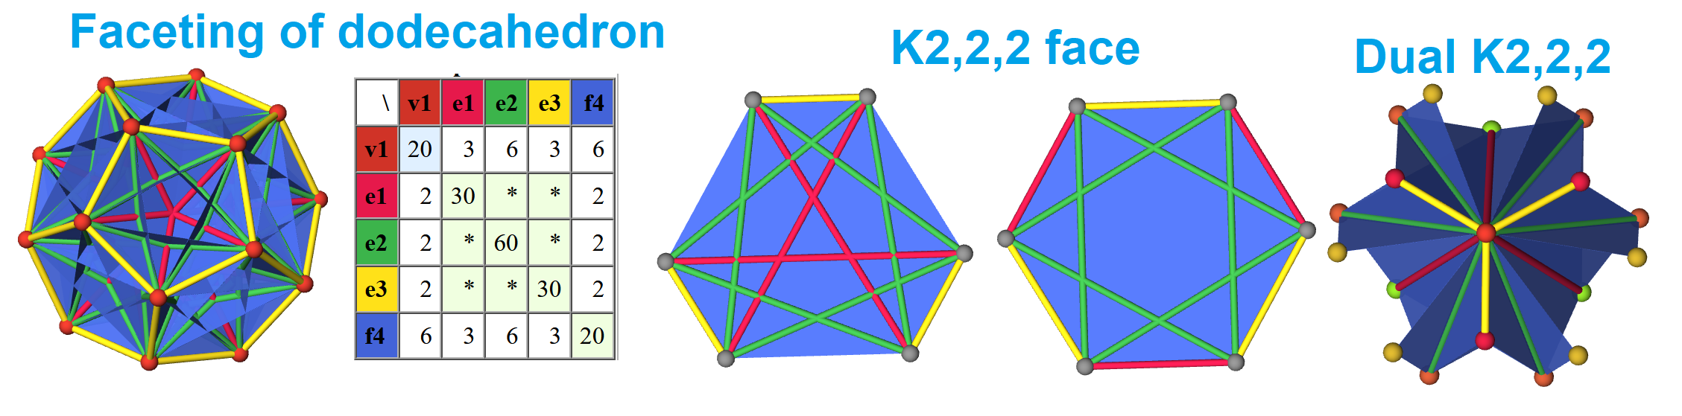
Another example
A second level faceting of a dodecahedral skeleton produces a 20 vertex, 20 face self-dual polyhedron, with 12 edges per face and 120 total edges.
The face is isomorphic to skeleton of octahedron, graph K_{2,2,2}.

Slide 15
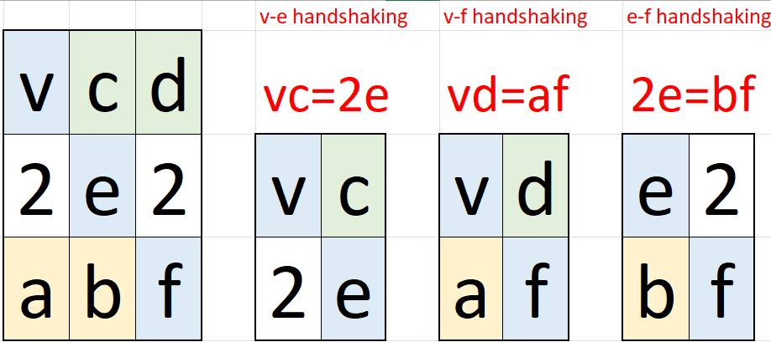
Regular polyhedra of the 4th kind
These new polyhedra can be seen as rank 3 incidence structures composed of 1 transitivity class of vertex, edge, and face.
Each edge has 2 vertices, and incident to 2 faces.
Faces are graph: a vertices, b edges, degree 2b/a. (a_{2b/a} b₂)
Vertex figures are graphs: c edges, d faces, degree 2d/c. (c_{2d/c} d₂)
How many more?! No one knows!
NEXT:
What small symmetric
graphs exist?

Slide 16
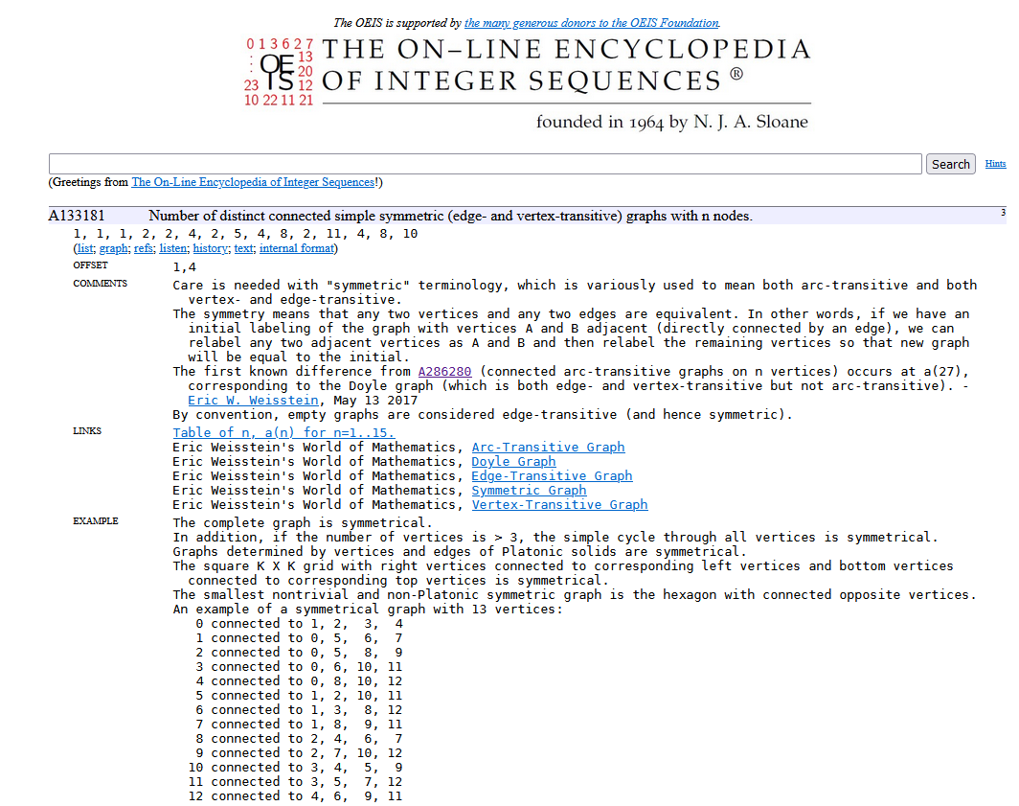
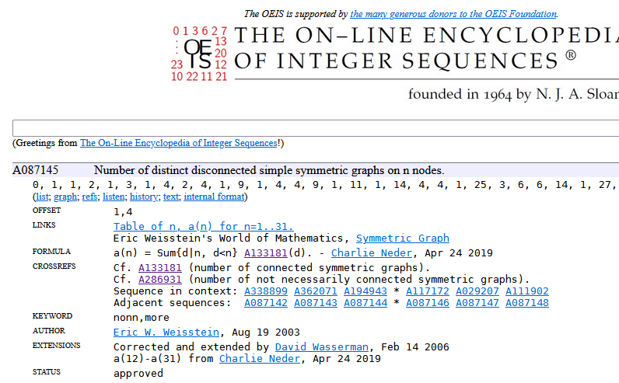
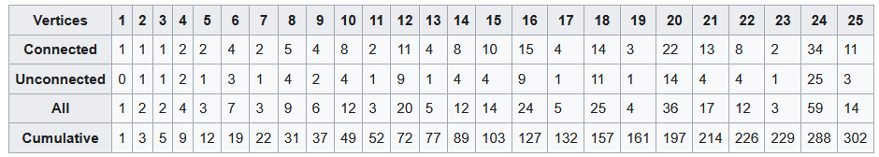
How many small symmetric graphs?
A133181 Number of distinct connected simple symmetric (edge- and vertex-transitive) graphs with n nodes
A087145 Number of distinct disconnected simple symmetric graphs on n nodes.

Slide 17

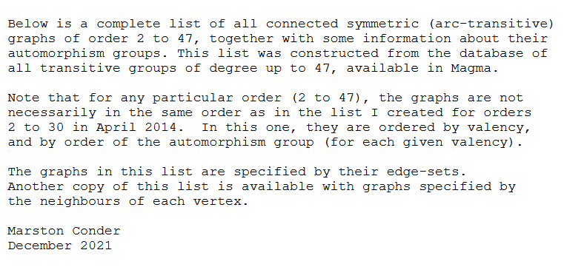
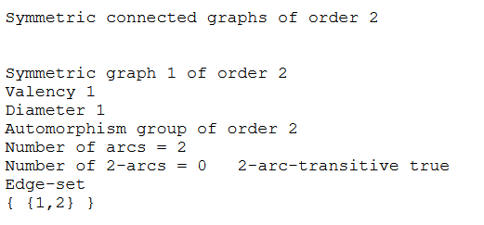
Dr. Marston Conder, 2021 Department of Mathematics, University of Auckland
A complete list of all connected symmetric
graphs of order 2 to 47! (previous up to 30)
Computed, indexed, but graphs are not named!

Slide 18
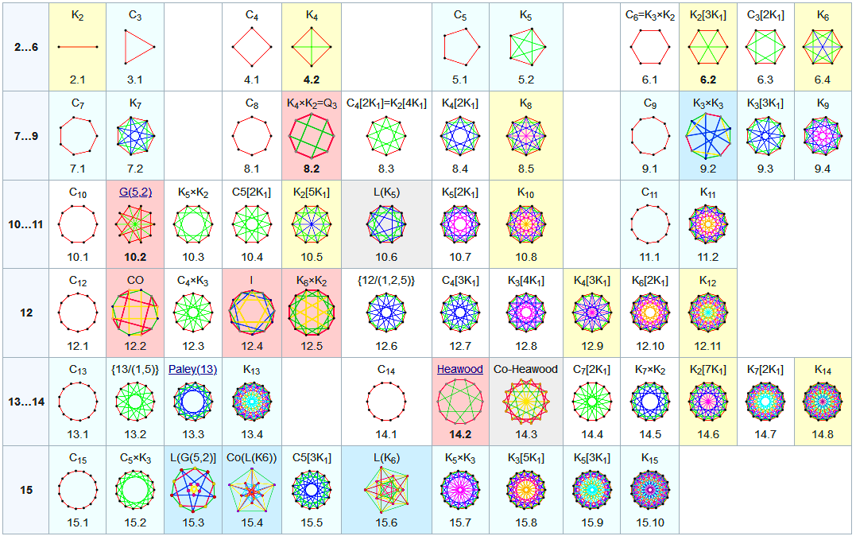
Symmetric connected graphs with 2…15 vertices
64 regular polygons of the 4th kind”, all but 12 are circulant. Blue odd-vertex, yellow odd-degree.

Slide 19
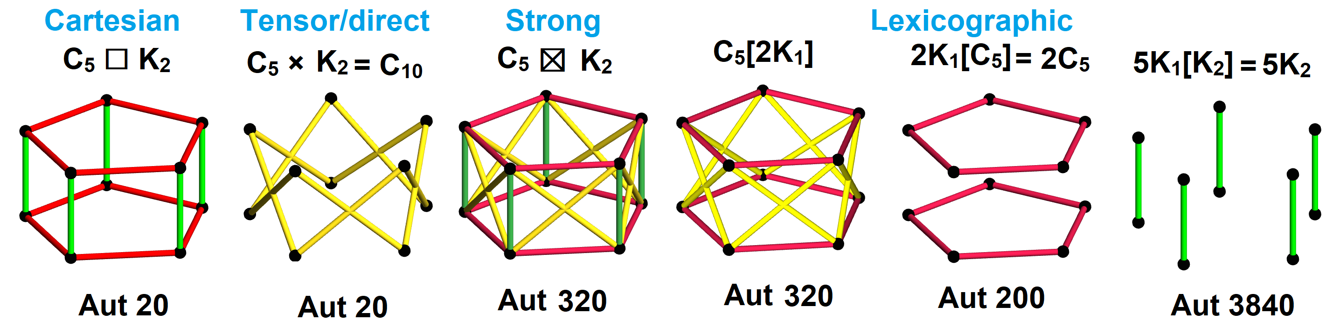
Graph products
Four important graph products: v_{G*H} = v_{G}v_{H}
Cartesian G□H : Prism if H=K₂ e_{G□H} = v_{G}e_{H} + e_{G}v_{H}
Tensor or direct G×H : diagonal edges, e_{G×H} = 2e_{G}e_{H}
Strong G⊠H : Union of both, e_{G⊠H} = v_{G}e_{H} + e_{G}v_{H} + 2e_{G}e_{H}
Lexicographic G[H] : e_{G[H]} = v_{G}e_{H}+e_{G}v_{H}² and if H=nK₁ , e_{G[nK1]} = n² e_{G}

Slide 20
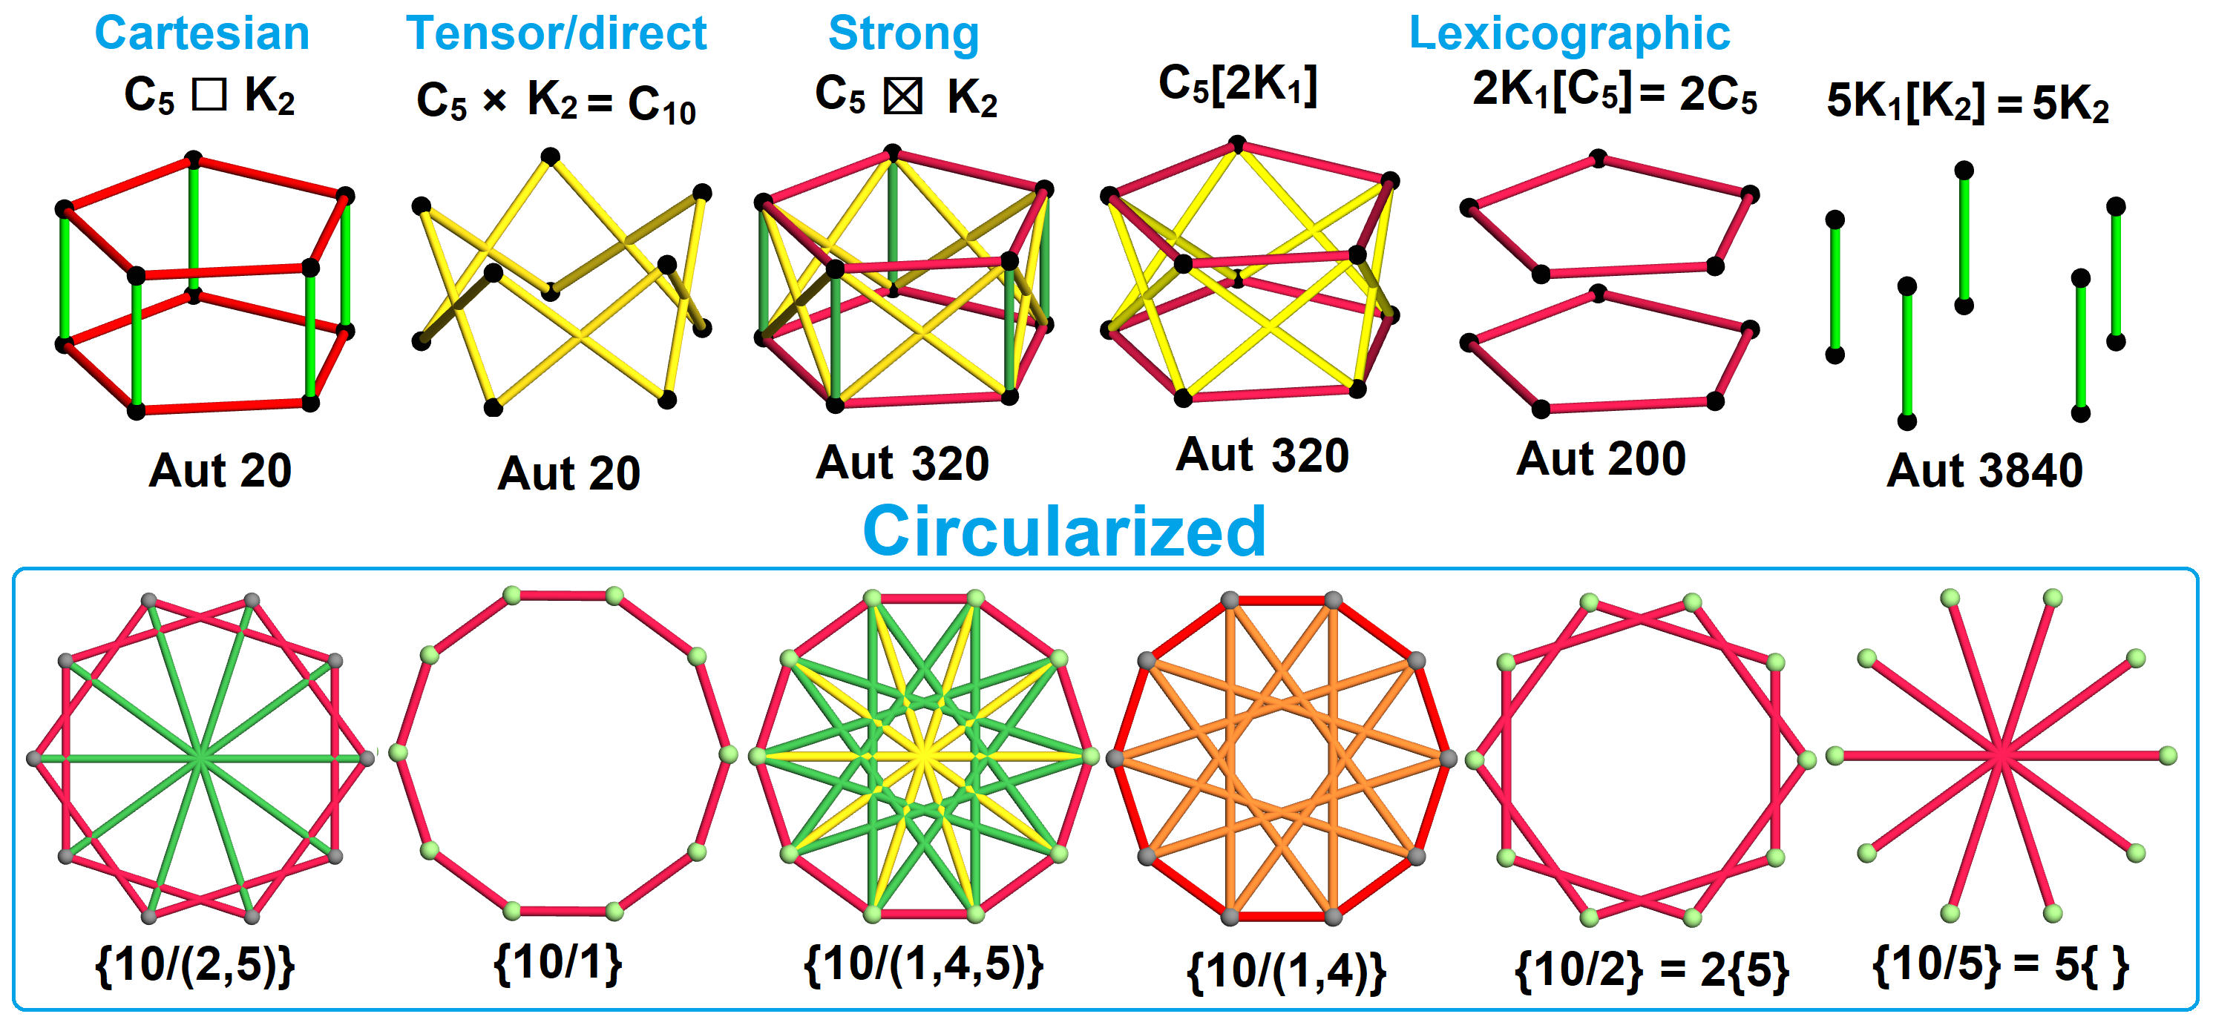
Circulant graphs Ci_{p}{q₁,q₂,…,q_{k}}
Multi-star polygon {p/(q₁,q₂,…)} = {p/q₁} ∪ {p/q₂} … (connecting edges every q₁, q₂ …)
Hamiltonian cyclic graphs can start with q₁=1, defining convex perimeter of p-gon.
Complete graphs index edges {1,2,…,p/2}.
Compliment graphs use complete graph complement set to {q₁,q₂,…}.

Slide 21
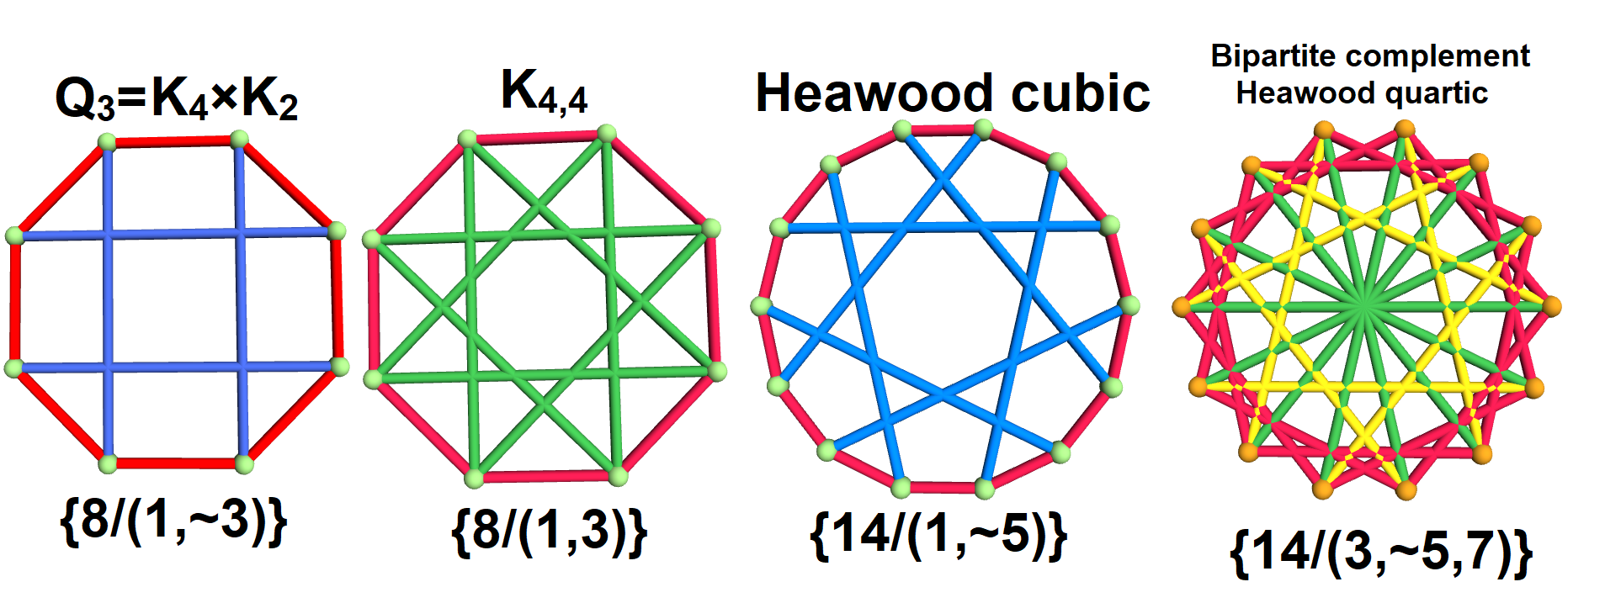
Bipartite circulant graphs
Bipartite graph circulants may include half paths of odd length, ~ symbol on length.
Cubic graph Q₃ misses 4 edges of K_{4,4} (cental diagonals of a cube)
Heawood graph and its bipartite complement are both edge transitive.

Slide 22
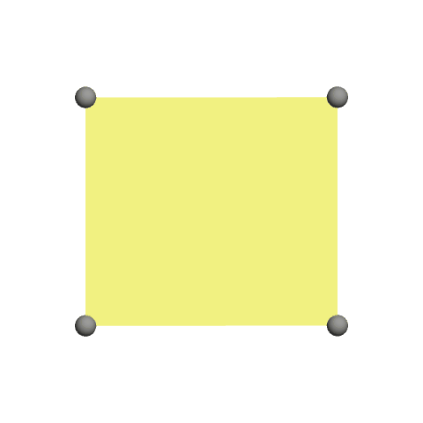
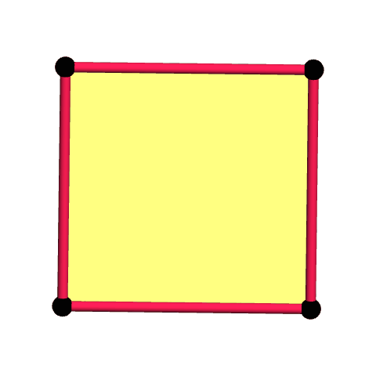
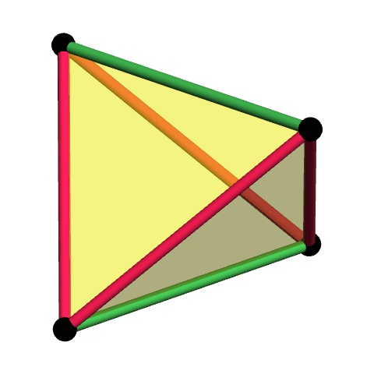
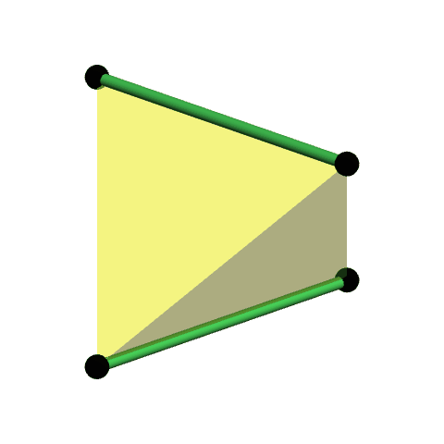
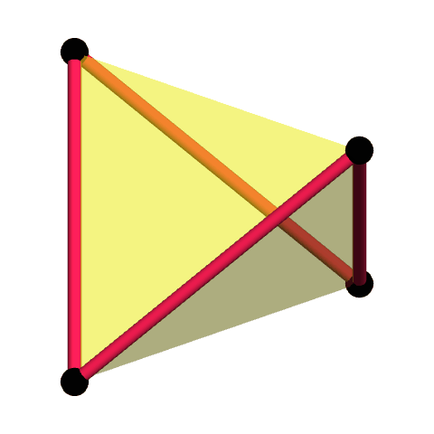
What is a regular polygon?
A v,e-transitive “body” attachable to other polygons edge-to-edge.
(Full symmetry may only be displayable in higher dimensions)
(1-polytope) First Kind Third kind Fourth kinds
Edgeless Flat Skew Tetrahedral Compound “tetron” square “square” “square” “square”
{4/0} {4/1} {2}#{ } {4/(1,2)} {4/2}

Slide 23
Regular polygons and polyhedra of the 4th kind!
Regular polyhedra of nth kind have nth kind of regular faces and vertex figure.
Allow regular convex faces and verfs
5 Platonic {3,p}, {p,3}, with p=3,4,5
Allow regular star faces and verfs
4 Kepler-Poinsots {5/2,p}, {p,5/2}, p=3,5
Allow regular skew faces or verfs
(a) Petrie infinite polyhedra (skew verfs): {4,6|4}, {6,4|4}, {6,6|3}
(b) Petrial regulars (skew faces): {3,p}_{π}, {p,3}_{π} {5/2,p}_{π} {p,5/2,p}_{π} with p=3,4,5
Allow symmetric graph faces and verfs
Finally begun being explored!
Allow symmetric hypergraphs faces and verfs
(a) Regular complex polygons in C² (~R⁴) and complex polyhedra in C³ (~R⁶).
(b) Projective geometries PG(3,k) and point-line-plane configurations

Slide 24
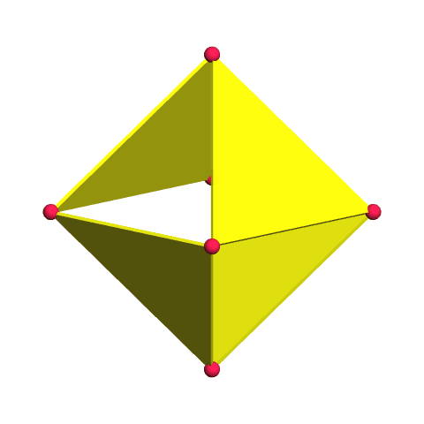
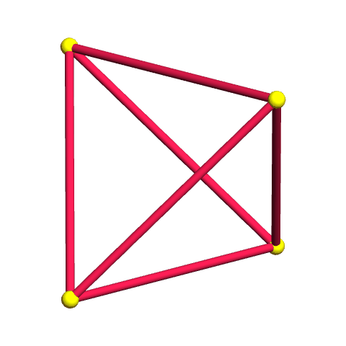
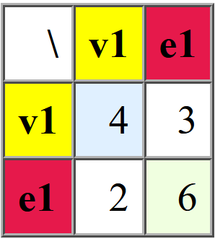
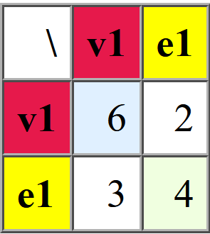
Regular Polygons of the 5th kind
Regular polygons as symmetric hypergraphs!
Complete Quadrilateral Complete Quadrangle
(4₃ 6₂) (6₂ 4₃)

Slide 25
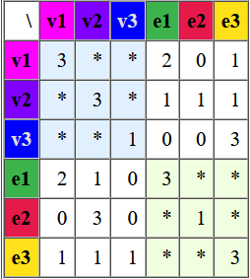
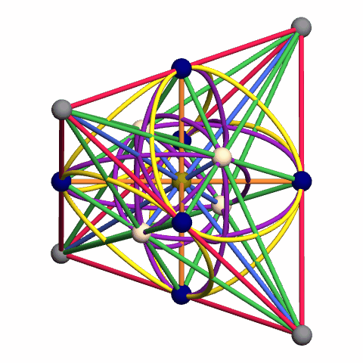
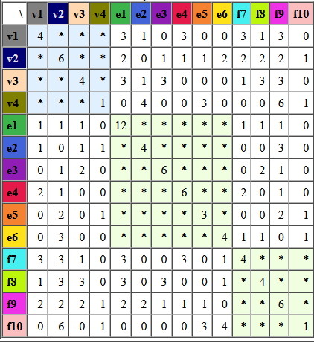
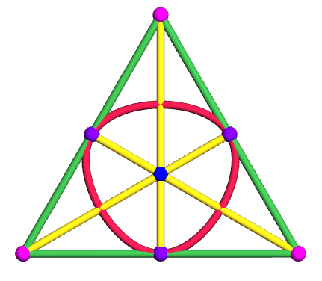
Projective Geometries
PG(2,2) is a Fano Plane, configuration (7₃), 7 vertices, 7 lines. (See PG incidence structures)
PG(3,2) is “polyhedron” with 15 vertices, 35 PG(1,2) trionic edges, and 15 PG(2,2) faces.
Both self-dual they can be drawn in triangle and tetrahedron with 3-vertex lines and circles.

